Slide 1



Slide 2








ORGANIZE

Slide 3


BACKGROUND
Results 2015
Video 2015
See inform
See video

Slide 4
EXPOALIMENTARIA THROUGH THE TIME
 | 2009 | 2010 | 2011 | 2012 | 2013 | 2014 | 2015 | % of increasing related to 2009
EXHIBITION AREA | 6,600m² | 12,000m² | 18,000m² | 20,500m² | 21,000m² | 23,000m² | 23,400m² | 355%
NATIONAL EXHIBITORS | 195 | 301 | 382 | 415 | 468 | 500 | 514 | 260%
INTERNATIONAL EXHIBITORS | 10 | 99 | 130 | 134 | 156 | 154 | 169 | 1690%
COUNTRIES IN EXHIBITION | 1 | 5 | 23 | 18 | 13 | 14 | 15 | 1500%
TOTAL VISITORS | 7,850 | 19,980 | 27,273 | 30,000 | 37000 | 32,594 | 43,613 | 556%
INTERNATIONAL VISITORS | 450 | 742 | 1,715 | 2,012 | 2,298 | 2,556 | 3,154 | 700%
VISITING COUNTRIES |  |  | 50 | 50 | 58 | 66 | 77 | 770%
NEGOTIATED AMOUNT | US$ 25M | US$ 69.1 M | US$ 471.7M | US$ 300M | US$ 660M | US$ 730M | US$ 800M | 320%

Slide 5

EXPOALIMENTARIA 2015 RESULTS

Slide 6
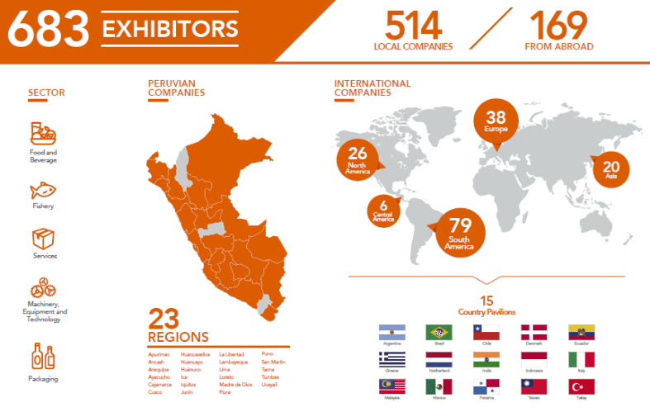
EXPOALIMENTARIA 2015 EXHIBITORS
In 2014, 654 exhibitors participated, 500 of them were national and 154 international. There were 14 country pavilions.

Slide 7
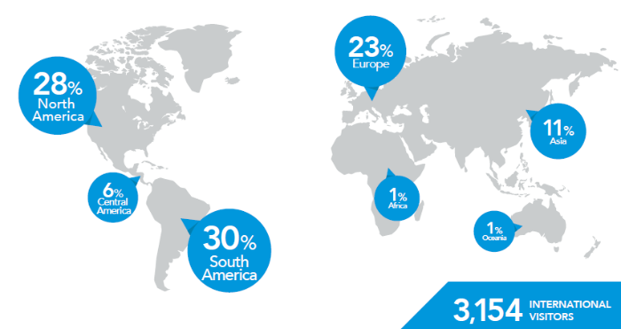
ORIGIN OF INTERNATIONAL
VISITORS
Top 10 countries
1
ESTADOS UNIDOS
15%
6
ECUADOR
6%
2
CHILE
11%
7
ARGENTINA
5%
3,154 international visitors
77 visiting countries
5 continents
3
BRASIL
7%
8
CHINA
5%
4
COLOMBIA
6%
9
MEXICO
4%
5
ESPAÑA
6%
10
ITALIA
3%
Notes:
2014
2,556 Visitantes
internacionales
76 países
05 continentes

Slide 8
INTERNATIONAL VISITORS
BY SECTOR
Sector | 2014 | 2015
FOOD AND BEVERAGE | 73% | 81%
FISHERY | 13% | 7%
PACKAGING/ MACHINERY / EQUIPMENT | 12% | 6%
SERVICES | 2% | 6%

Slide 9
INTERNATIONAL VISITORS
BY DISTRIBUTION CHANNEL
Distribution channel | 2014 | 2015
IMPORTERS | 28% | 29%
EXPORTERS | 14% | 22%
SUPERMARKETS / HORECA | 8% | 15%
WHOLESALERS | 11% | 10%
RETAILERS | 7% | 9%
FOOD PROCESSORS | 6% | 6%
PRODUCERS | 4% | 5%
SERVICE PROVIDERS | 5% | 4%
TRADERS * | 7% | 0%
OTHERS * | 10% | 0%
(*) Categories considered only in 2014.

Slide 10

BUSINESS MATCHMAKING
Notes:
2014
-730 millones de dólares negociados
+ de 600 citas desarrolladas en rueda de negocios
2015
-750 millones de dólares negociados

Slide 11

TOP 10
DE
PRODUCTS

Slide 12


+1,640 exhibited products.
+32 category products.

Slide 13
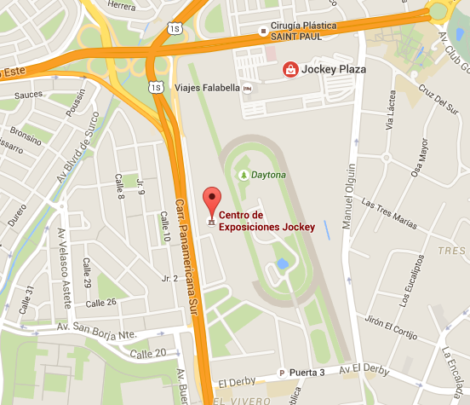
LOCATION AND DATE
LOCATION : Jockey Exhibition Center
DATE : 28, 29 & 30 september 2016.
SCHEDULE :
Exhibitors 09:00 hrs. to 20:00 hrs.
Visitors 10:00 hrs. to 19:00 hrs.

Slide 14
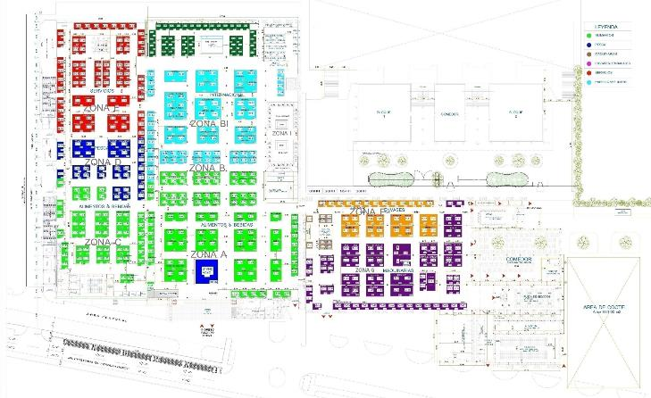

EXPOALIMENTARIA LAY-OUT FOR 2016
Services
Area
International pavilions
Fishery
Area
Packaging Area
Food and Beverage Area
Machinery
Area

Slide 15






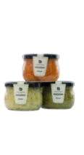
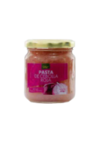


Winners 2015
Categories
Beverages and liquors
Biocommerce and natural products
Cocoa, coffee and subproducts
Confectionery and snacks
Fruits and vegetables
Functional and nutraceutical
Andean grains, sedes, cereals and legumes
Gourmet products and prepared meals
Dairy products and derivatives

Slide 16



+1,000 participants

Slide 17


1,200 visitors during the three days
19 masters classes
Distinguished chefs
Highlighted inputs
National and International Chefs
Diego Muñoz / Astrid & Gastón
Cesar Choy / Maido
Pedro Miguel Schiaffino / Malabar
Flavio Solórzano / Señorío de Sulco
Diego Balarezo / Mercado Gourmet
Israel Laura / Kañete
Francesco de Sanctis / Sibaris
Yaquir Sato / Costanera 700
Eduardo Fujihara / Hanzo
Hervé Galidié / Restaurante Hervé
Ximena Llosa / Chef of Oh Diosas
Talia Schvartzman / Professional Nutritionist
Cecilia Alfaro / American Culinary Federation
Arlette Eulert Checa / Matria

Slide 18




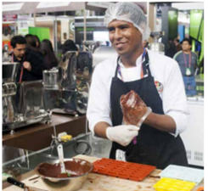

Showing the transformation of coffee grains.
Cooperatives from San Martín, Ayacucho, Junín, Puno and others.
+350 visitors during
the three days of
the show.

Slide 19

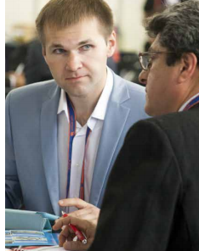

HOSTED BUYER PROGRAM
The goal of this program is to guarantee the presence of high-level professionals and with purchase decision-making power in Expoalimentaria 2016.
Process
Registration of applicants.
The Technical Committe evaluates buyers who meet the required profile.
Communication from the Technical Committee to the OCEX or Embassy and the applicants of the program.
Profile
Importer/Supermarket/Trader/Distributor.
Interested in buying food (agriculture and fishery sector) exhibited in the fair.
The company must have website.
In preference, companies that have no made business with Peru yet.
Complete the registration form with all the required information.

Slide 20



HOSTED BUYER PROGRAM
Benefits
One (1) air ticket "non stop" - economy class - to assist to the fair.
Transfer service: airport - hotel *– fair.
Free admission to the fair.
Free access to the business matchmaking platform and to its location.
Access to the buyers VIP room.
Special invitation to the Welcome Cocktail.
* Only for Official Expoalimentaria 2016 Hotels.
Obligations
Visit the fair at least 2 days.
Schedule and participate in at least 6 meetings with exhibitors of your interest through the software.
Considerations
Applying does not guarantee to get the whole benefits and it is subject to a limited number.
The Organization reserves the right to accept or decline your application.
Results will be communicated starting on April.
Once the benefits are accepted, the applicants have a limited time to confirm their attendance.
Participants have to cover other expenses that were not mentioned in the Hosted Buyer program.
The registration form must be fully completed; otherwise, your application will not be processed.

Slide 21

TRADE MISSIONS
6 trade missions from Colombia, Argentina, Francia & China in 2015.
Profile
Importer / Supermarket / Trader / Distributor/ Exporter
Interested in buying products or services exhibited in the fair.
Complete the registration form with all the required information.
Benefits
Provide an air ticket to the representative of the entity that brings together a mission of multi sectoral visitors, according to the required profile. (The number of firms depends on the country of origin).
Transportation: Airport-official hotel, official hotel-fair-hotel.
Free entry to the fair.
Access to the buyers VIP room.
Considerations
Last day: May 18th, 2016.
Available just for companies that do not apply to Hosted Buyer program.
Number of companies according to their origin
CONTINENTS | N° COMPANIES
NORTH AMERICA | 12
SOUTH AMERICA | 12
CENTRAL AMERICA | 10
EUROPE | 10
ASIA | 8
AFRICA | 4
OCEANIA | 4

Slide 22


Slide 23


