Slide 1
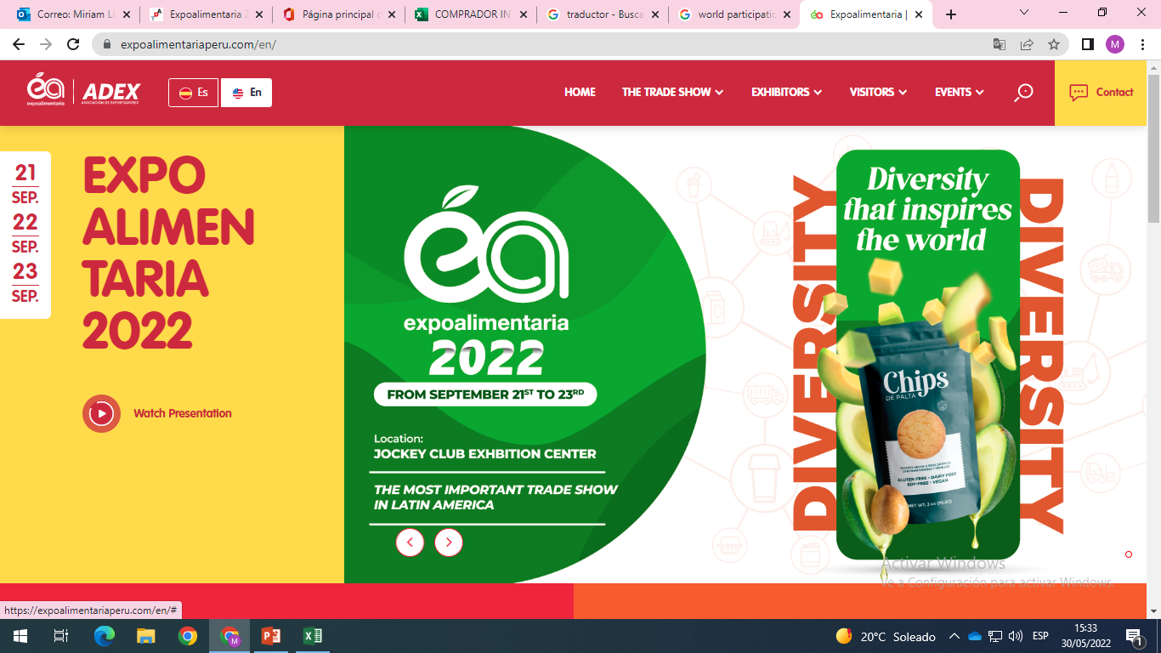

Slide 2

Organizer
Co-Organizers:

Slide 3
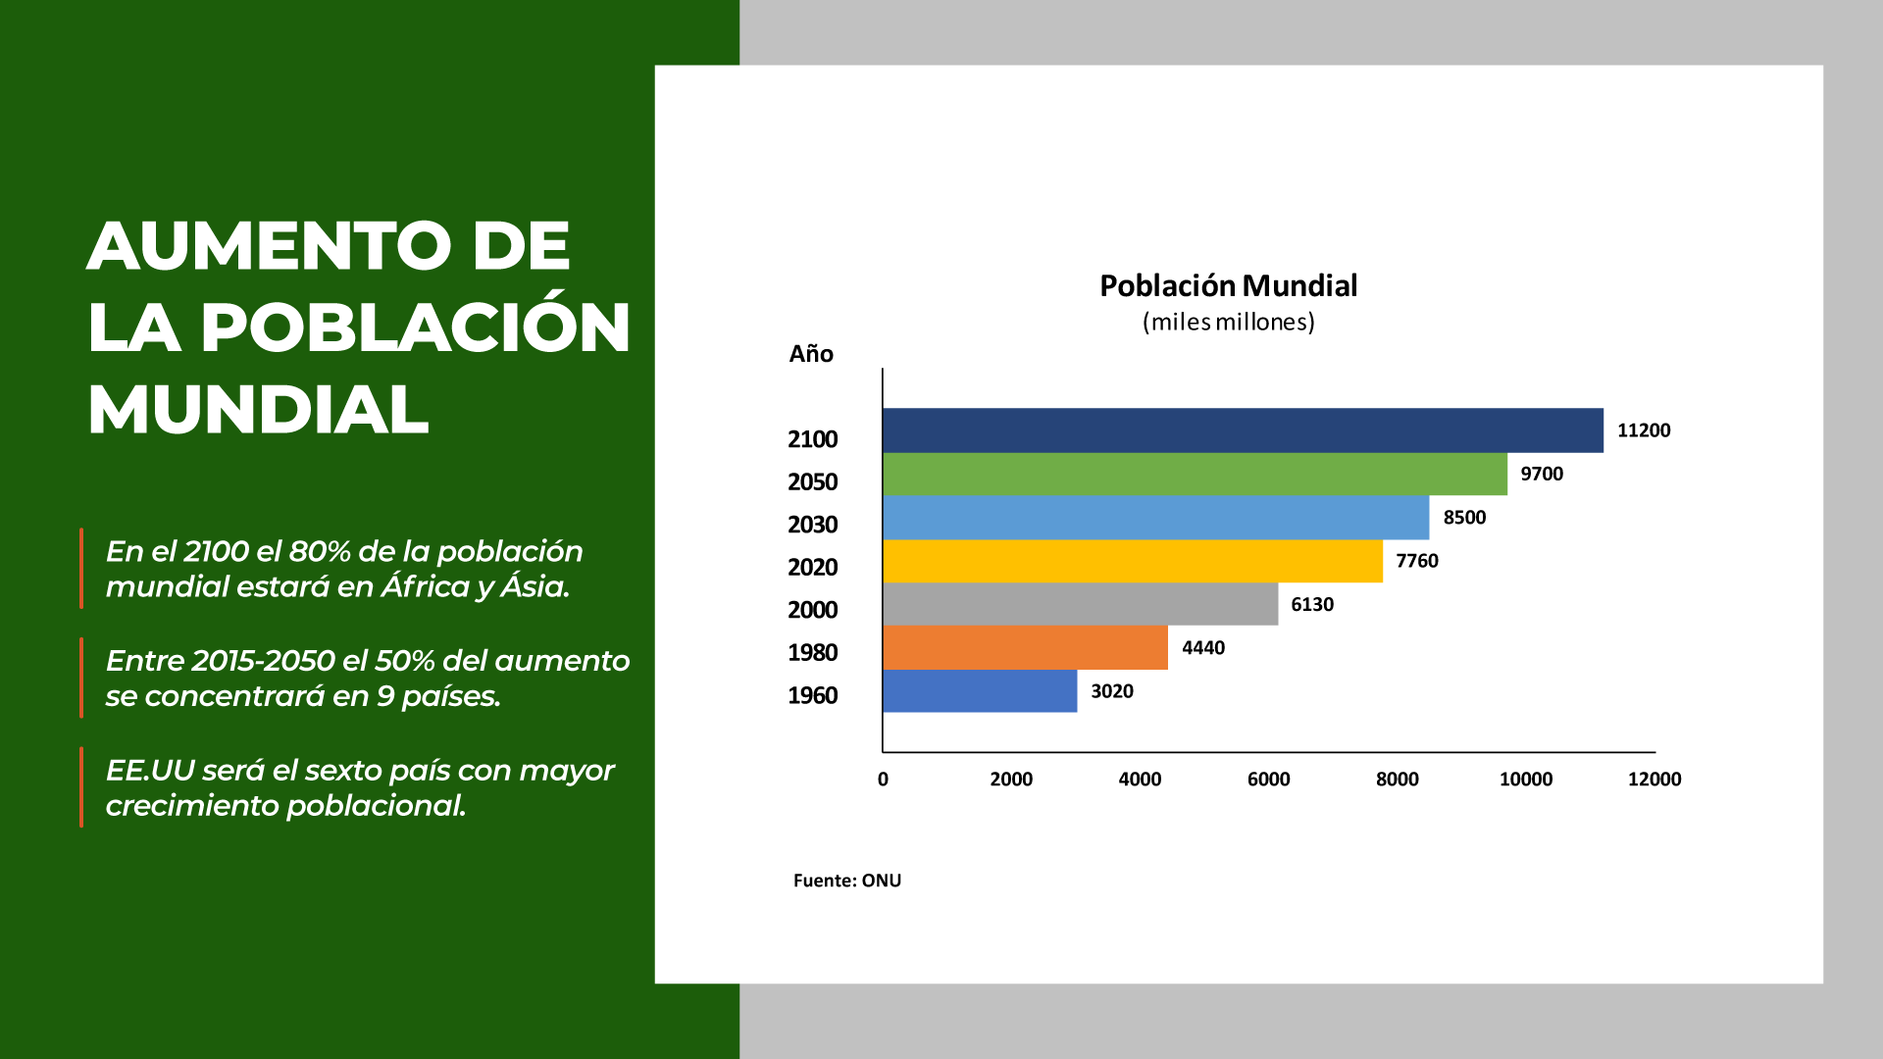
WORLD POPULATION GROWTH
World population growth rate
In 2100, 80% of the world's population will be between Africa and Asia.
Between 2015 - 2050, 50% of the increase will be concentrated in 90 countries
EE.UU will be the 6th country with the highest population growth
Source: United Nations

Slide 4
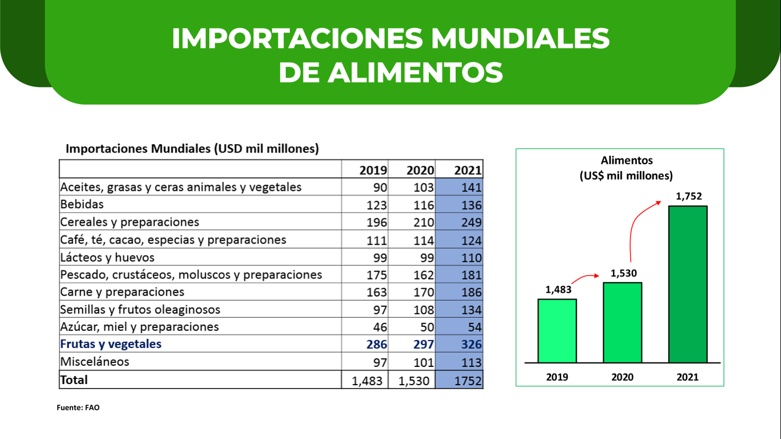
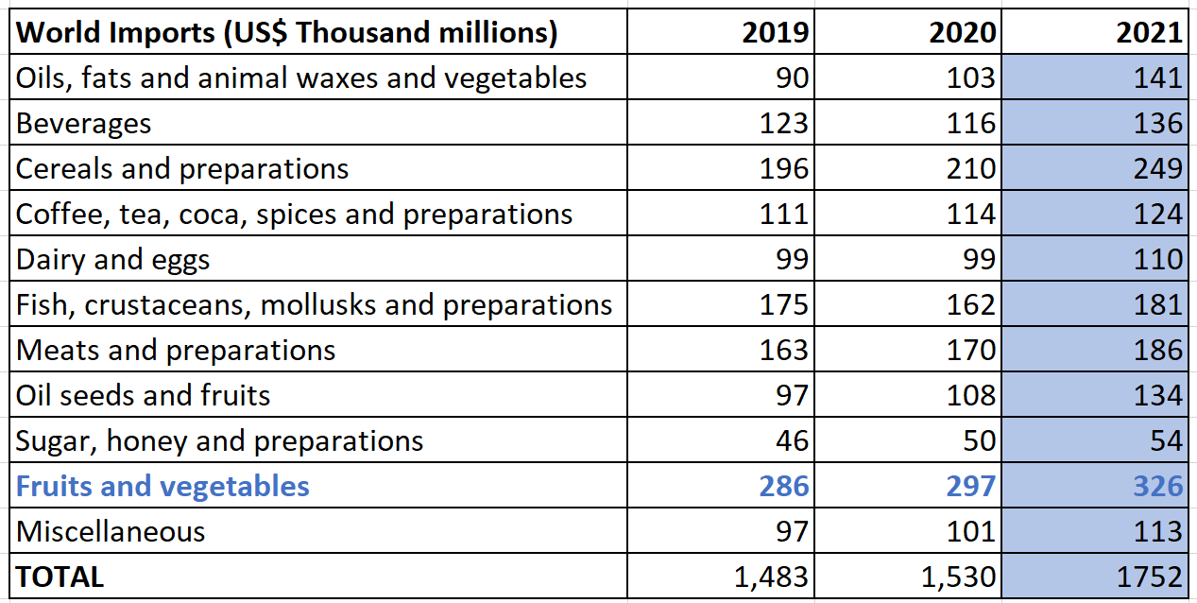
WORLD FOOD IMPORTS
Foods
World Imports ( US$ Thousand millions)
Oils,fats
Beverages
Cereals and preparations
Coffe, tea, cocoa, espices and preparations
Dairy and eggs
Fish, crustaceans, molluscs and preparations
Meats and preparations
Oil seeds and fruits
Sugar, honey and preparations
Fruits and vegetables
Misellaneous
Source: FAO

Slide 5
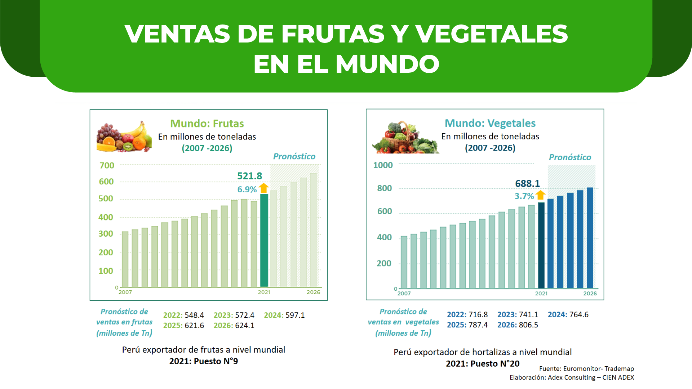
WORLDWIDE SALES OF FRUITS AND VEGETABLES
World: Fruits
World: Vegetables
In million tons
In million tons
Forecast
Forecast
Fruit sales forecast
(In million tons)
Vegetable sales forecast
(In million tons)
Peru exporter of fruits worldwide
2021: Position N°9
Peru exporter of vegetables worldwide
2021: Position N°20
OMONITOR -TRADEMAP
ELABORATED: ADEX CONSULTING CIEN - ADEX

Slide 6
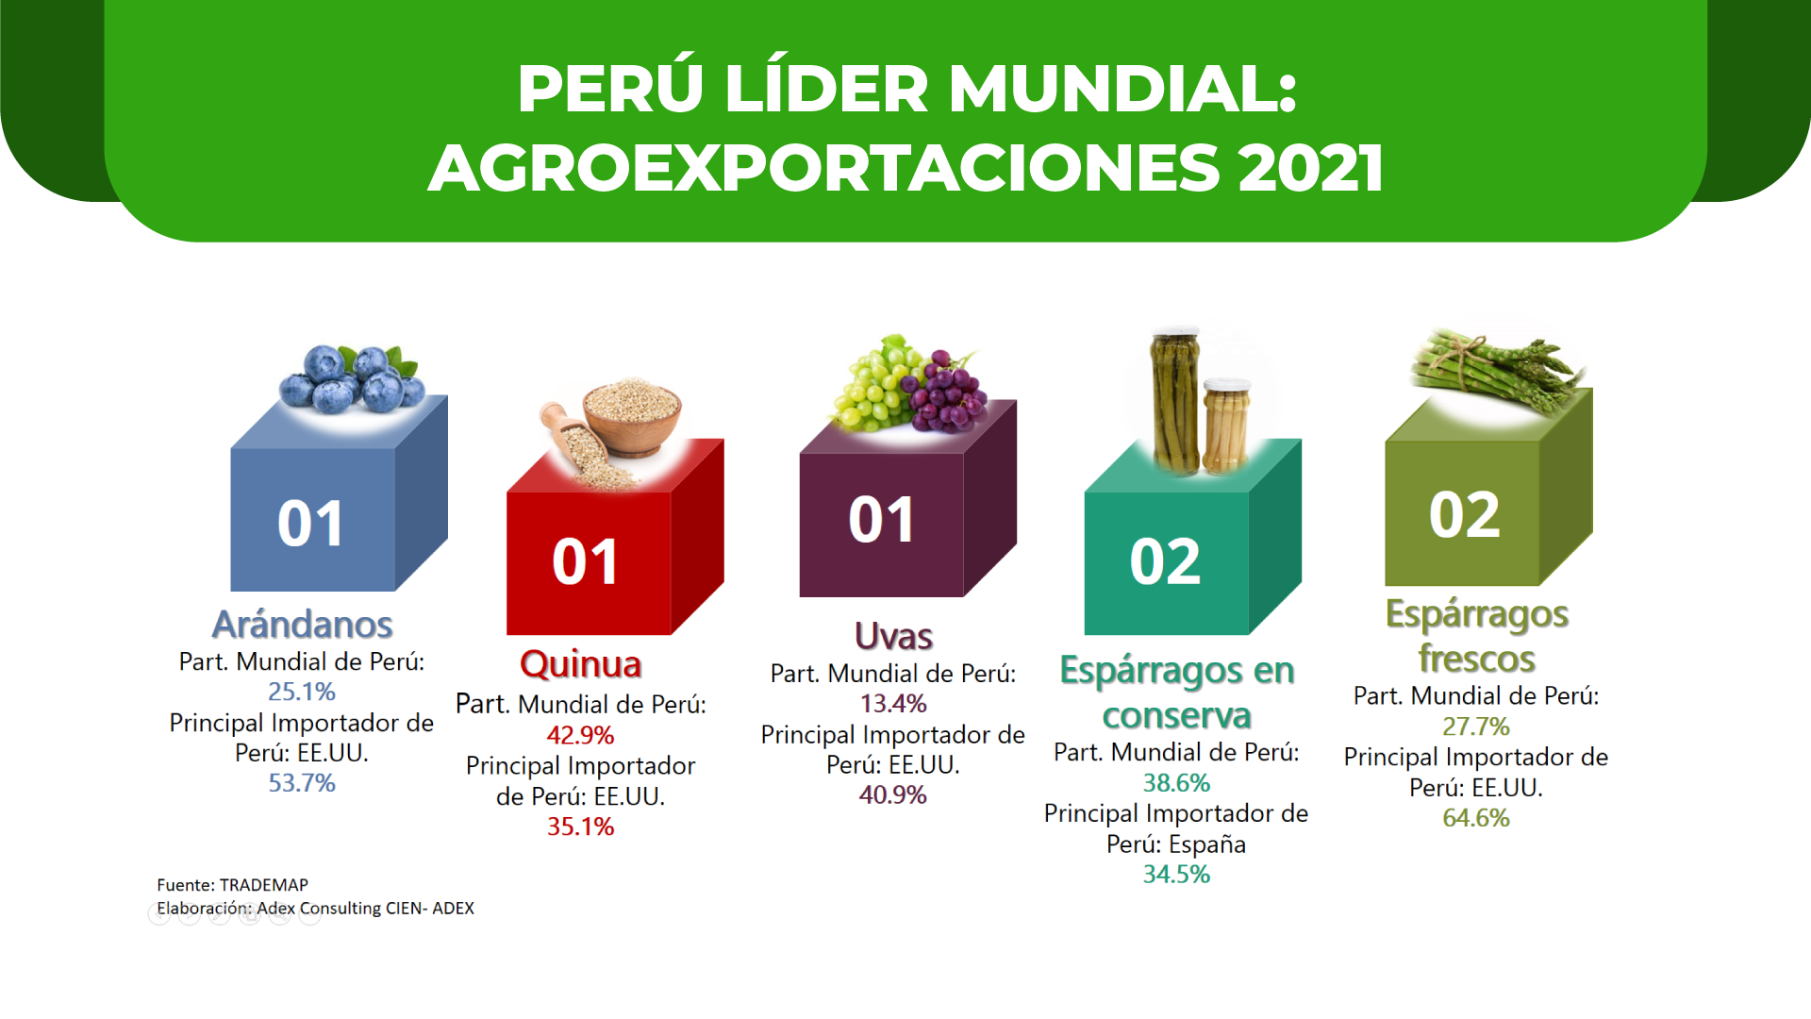
PERÚ WORLD LEADER: AGROEXPORTS 2021
BERRIES
GRAPES
FRESH SPARRAGUS
World participation of Peru
QUINOA
World participation of Peru
CANNED ASPARAGUS
World participation of Peru
Main importer of Peru: USA
World participation of Peru
Main importer of Peru: USA
World participation of Peru
Main importer of Peru: USA
Main importer of Peru: USA
Main importer of Peru: Spain
SOURCE: TRADEMAP
ELABORATED: ADEX CONSULTING CIEN - ADEX

Slide 7
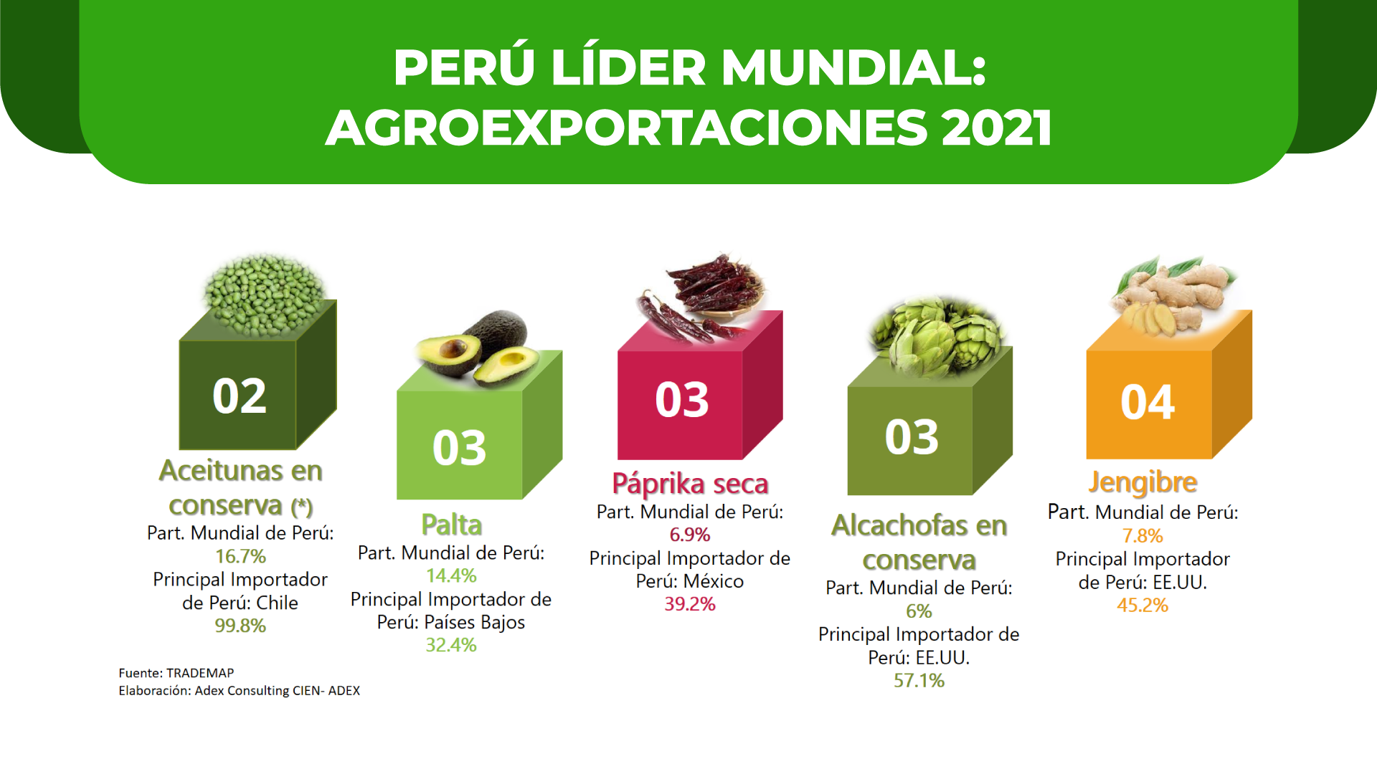
PERÚ WORLD LEADER: AGROEXPORTS 2021
CANNED OLIVES
DRY PAPRIKA
GINGER
AVOCADO
World participation of Peru
CANNED ARTICHOKES
World participation of Peru
World participation of Peru
World participation of Peru
Main importer of Peru: Mexico
Main importer of Peru:USA
Main importer of Peru: Chile
World participation of Peru
Main importer of Peru: Netherlands
Main importer of Peru: USA
SOURCE: TRADEMAP
ELABORATED: ADEX CONSULTING CIEN - ADEX

Slide 8
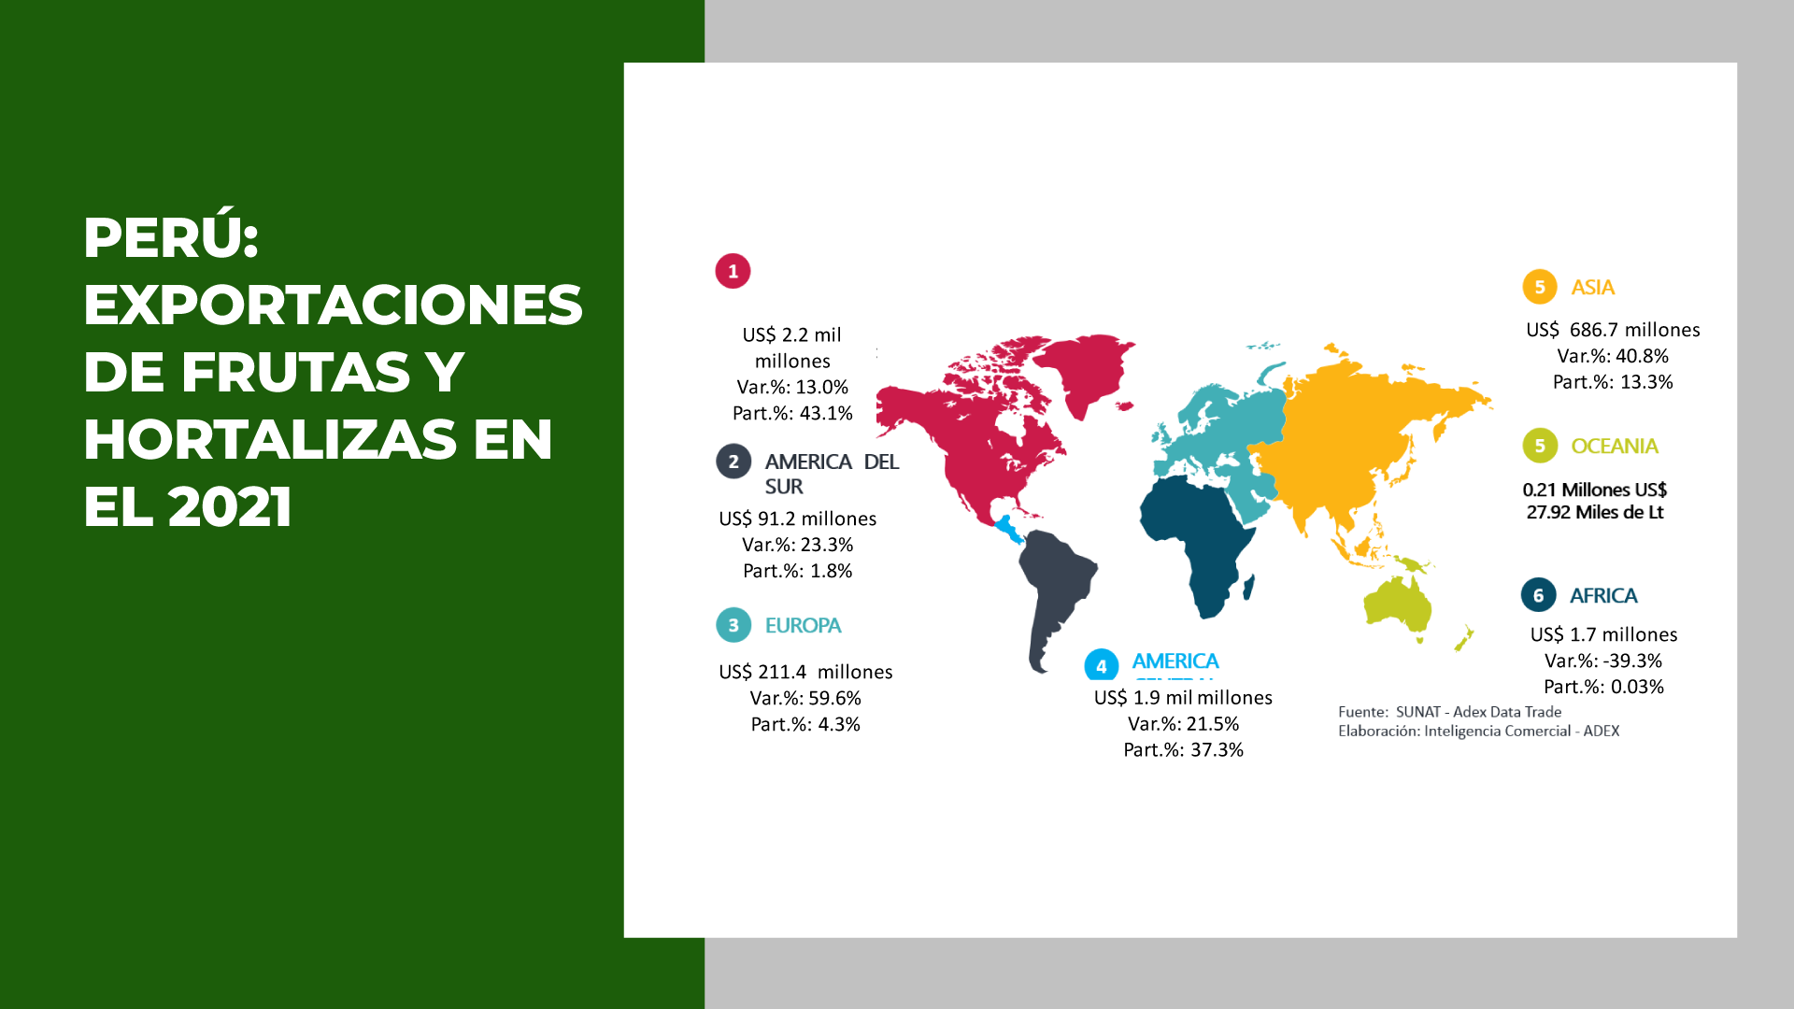
PERÚ: EXPORTS OF FRUITS AND VEGETABLES 2021
NORTH AMERICA
Thousand Millions
Millions
SOUTH AMERICA
Millions
Millions
EUROPE
Millions
Millions
CENTRAL AMERICA
Thousand Millions
SOURCE: SUNAT – ADEX DATA TRADE
ELABORATED: BUSINESS INTELLIGENCE - ADEX

Slide 9
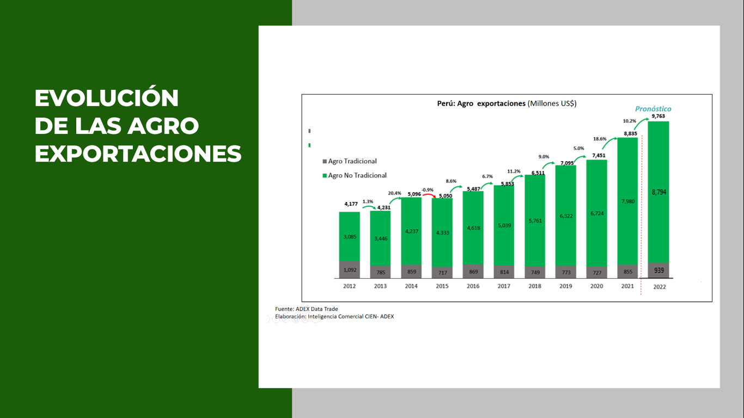
EVOLUTION OF AGRO EXPORTS
Peru: Agro Exports (Millions US$)
Traditional Agro
No traditional Agro
SOURCE: TRADEMAP
ELABORATED: ADEX CONSULTING CIEN - ADEX

Slide 10

The most important food and beverage fair in Latin America, which has been consolidated for 14 years within the route of the most important buyers from the 5 continents.

Slide 11
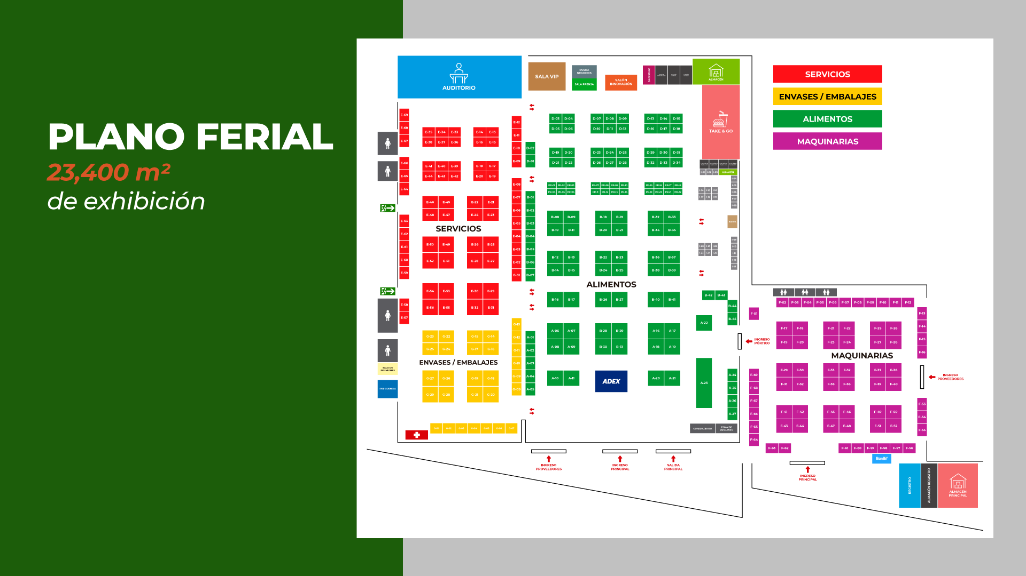
SERVICES
FlOOR PLAN
AUDITORIUM
CONTAINERS / PACKAGING
FOODS
MACHINERY
OF EXHIBITION
SERVICES
FOODS
CONTAINERS / PACKAGING
MACHINERY

Slide 12
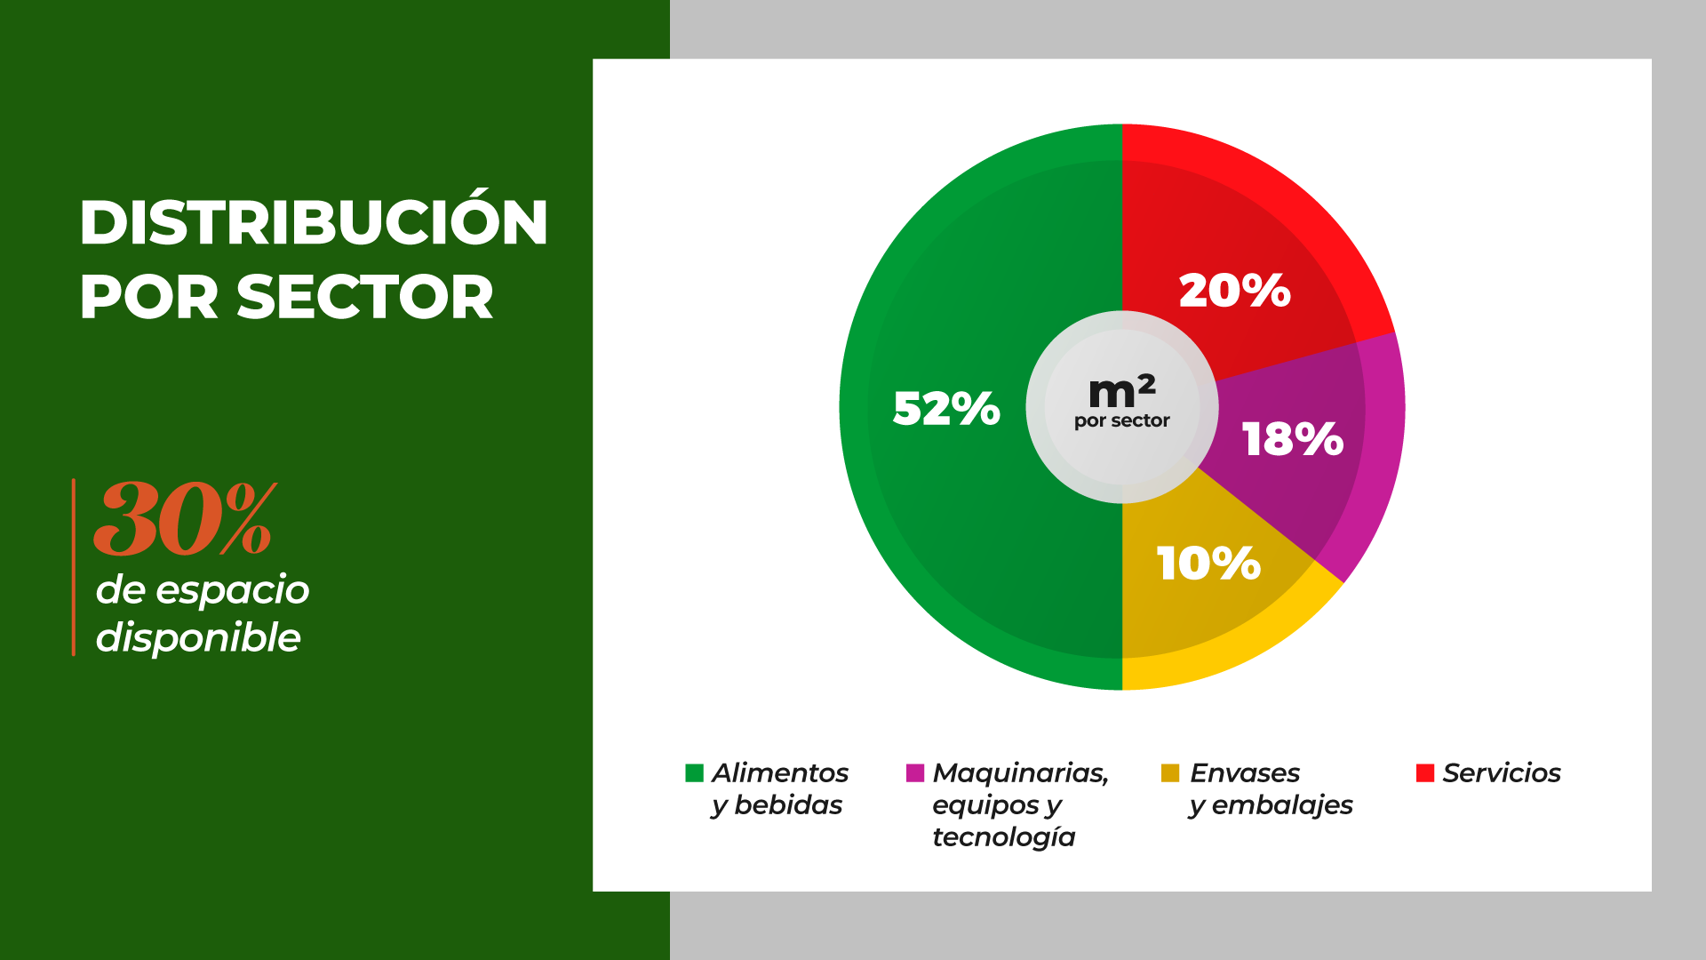
DISTRIBUTION BY SECTORS
Per sector
AVAILABLE SPACE
Foods and Drinks
Containers and packaging
Machinery, equipment and technology
Services

Slide 13


COMMERCIAL SHOWCASE OF LATIN AMERICA
We expected more than:
Sectors
Food and Beverages
Services
EXHIBITORS
Regional Goverments
Country Pavilions
Top Exporters companies
Machinery, equipments and Technology
Pack and Packaging

Slide 14
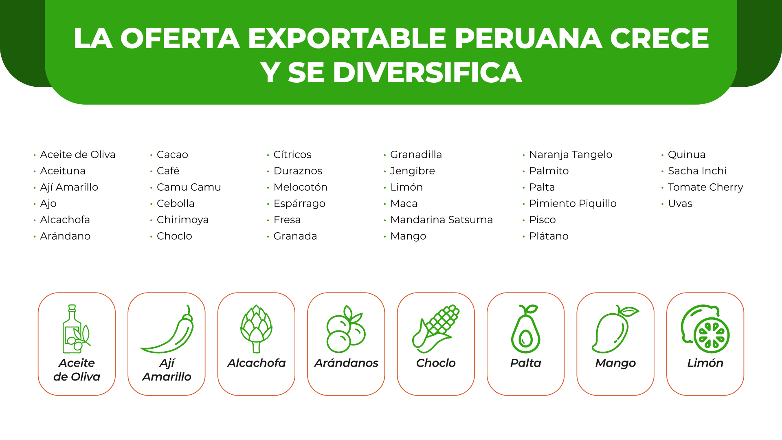
THE PERUVIAN EXPORTABLE SUPPLIES GROWS AND DIVERSIFIED
Olive oil
Olive
Yellow pepper
Garlic
Artichoke
Berry
Cacao
Coffee
Golden berry
Onion
Custard
Corn
Citrus
Peach
Asparagus
Strawberry
Pomegranate
Passion fruit
Ginger
Lemon
Maca
Satsuma Mandarin
Mango
Tangelo orange
Palmetto
Avocado
Piquillo Pepper
Pisco
Banana
Quinoa
Sacha Inchi
Cherry tomato
Grape
Olive Oil
Yellow pepper
Artichoke
Berries
Corn
Avocado
Mango
Lemon

Slide 15

MACHIINERY AND SERVICES FOR FOOD INDUSTRY
Design and engineer on industrial refrigeration
Storage and cargo services
Machinery for Food process to pack and packaging food
Financial advisory services
Equipment, instruments and consumables for quality control laboratory
Inspection and training services
Foreign trade services
Analysis and certification services Food

Slide 16
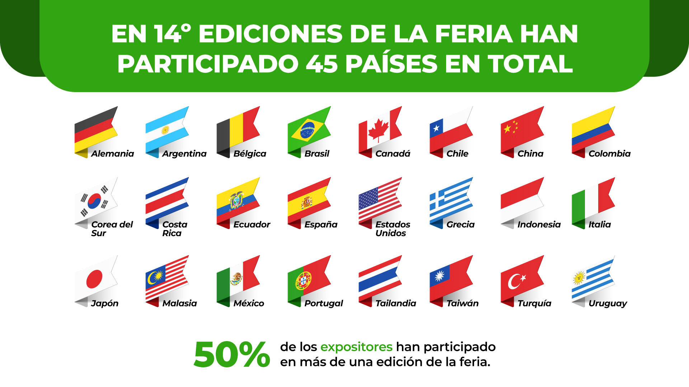
IN THE 14 EDITIONS OF THE FAIR, A TOTAL OF 45 COUNTRIES HAVE PARTICIPATED
Germany
Belgium
South Korea
Spain
United States
Greece
Italy
Japan
Malaysia
Thailand
Turkey
Of the exhibitors have participated in more than one edition of the fair

Slide 17


COUNTRY PAVILIONS PARTICIPATING
EXHIBITOR COMPANIES PARTICIPATING
Food and Beverages Sector

Slide 18

VISITOR PROFILE
Main Head Buyers of the most important supermarket, retails, boutiques, importers, trades, Food providers, wholesalers.
Total Visits in 2019 Edition
International Visitors in 2019 Edition
More tan 150 VIP Buyer, invited with air tickets and accommodation covered, to meet our exhibitor companies and make business
Continents
Get in touch with new providers and meet new products
Do business with more than one company in the following 12 months

Slide 19
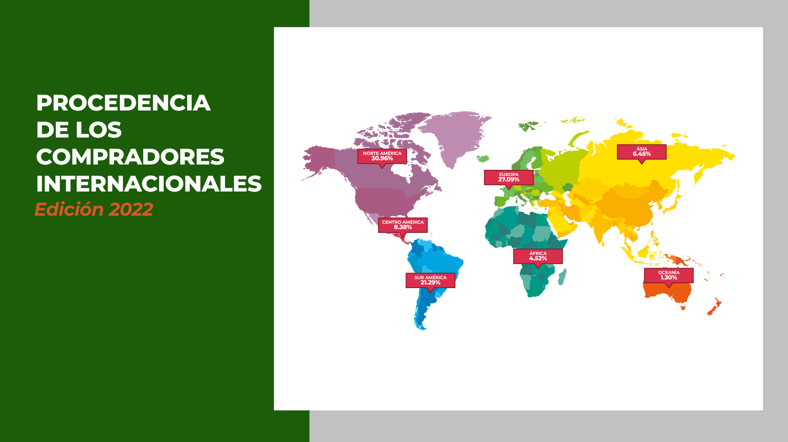
ORIGIN OF INTERNATIONAL BUYERS
Edition 2022

Slide 20

INTERNATIONAL BUYERS PARTICIPATING
TOP 05
DEMAND PER CATEGORY
United States
Holland
Sweden
Italy
United States
Japan

Slide 21
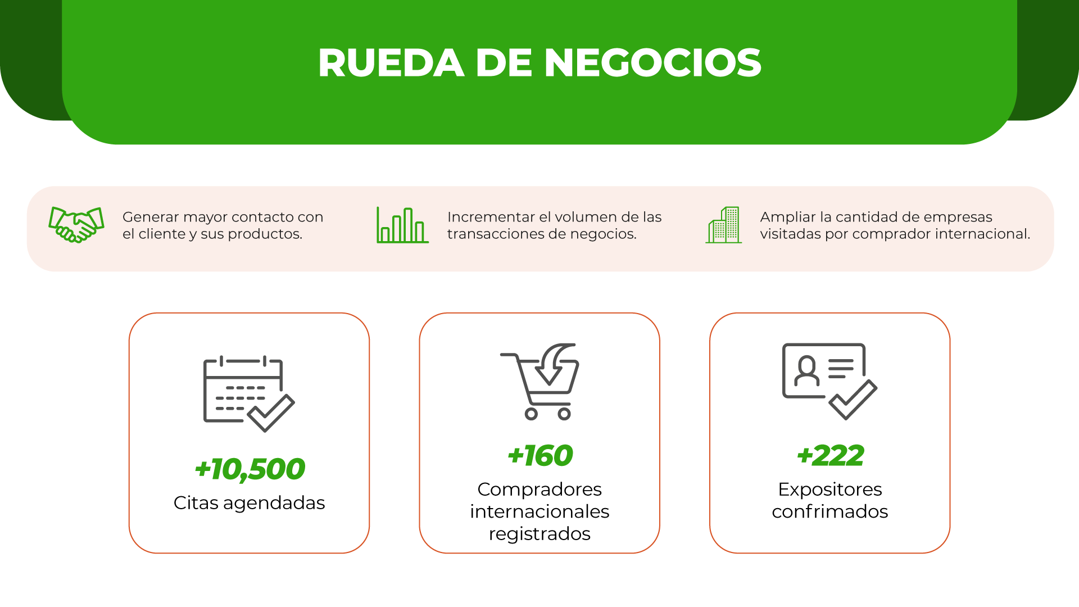
BUSINESS MATCHMAKING
Generate more contact with the client and their products.
Increase the volume of business transaction.
Increase number of companies visited by international buyers.
Scheduled appointmets
International buyers registered
Cofirmed Exhibitor

Slide 22

“RECOGNITION OF CREATIVITY AND INNOVATION IN THE DEVELOPMENT OF NEW PRODUCTS”
BEST INNOVATIVE PRODUCT
Main prize
We reward trends in food innovation 2022
Healthy Lifestyle Pleasure Practicality Ecofriendly

Slide 23

MASTER CONFERENCES
Recognized national and international speakers
Most important and current issues
Experiences and good practices

Slide 24

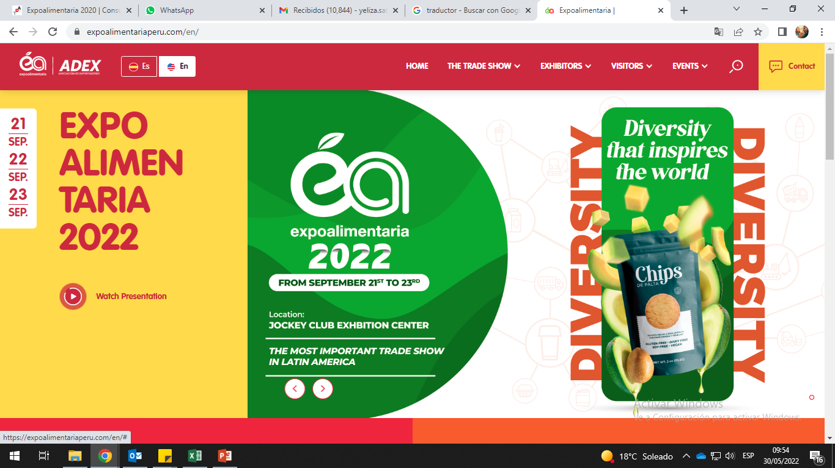
SALE OF TICKETS
Payment:

Slide 25

SPONSORS

Slide 26

From September 21st to 23rd

