Slide 1


Slide 3






PROINVERSIÓN: About us
The Private Investment Promotion Agency - PROINVERSIÓN, is a specialized technical agency, attached to the Ministry of Economy and Finance, with legal status under public law and technical, functional, administrative, economic, and financial autonomy. It was created in 2002.
It promotes private investment through Public-Private Partnerships (PPP), Projects in Assets (PA) and Works for Taxes (OxI).
Our mission is to promote private investment in infrastructure and public services for the benefit of all Peruvians with technical leadership, transparency and quality.
Our vision is: “To be an agency recognized by investors and the population as an effective strategic ally for investment development in Peru.”

Slide 5









Goals in the portfolio of PPPs and PAs 2023 (Up to 18 projects)
No | PROJECT | Original amount (USD mil.) | Awarded amount (USD mil.) | Competition factor | Adjudication | Successful bidder
1-2 | Group 3 – Ica-Poroma Link and Cáclic-Jaén Link ITC | 132 | 73* | Lower total service cost (-45%) | Jan – 23
3-4 | AWS-3 and 2.3 GHz Bands | 268 | 640* | Greater number of benefited communities | Jun – 23
5-6 | Essalud Hospitals of Piura and Chimbote | 323 | 323* | Lower co-financing 100% | Jun – 23
7 | 500 kV Piura Nueva-Frontera Substation TL | 233 | 108* | Lower total service cost (-54%) | Jul – 23
8-10 | 220 kV Belaunde Terry – Tarapoto North Link, 500 kV San José – Yanabamba link and 220 kV Piura Nueva – Colán link | 141,56 | 85,97 | Lower total service cost (-39%) | Aug – 23
11-12 | 220 kV Lambayeque North ITC Substation with division and Piura East Substation | 38,9 | 32,16 | Lower total service cost (-17%) | Aug – 23
JANUARY – AUGUST 2023
We have awarded 66% to the annual goal projects.
12 awarded projects for
US$ 1,262 MM
*Amounts are considered based on the estimated offered amounts and based on the estimated investment in localities (AWS-3 and 2.3 GHz bands).

Slide 6



Goals in the portfolio of PPPs and PAs 2023 (Up to 18 projects)
SEPTEMBER – DECEMBER 2023
Upcoming awards
6 projects for more than US$ 2,400 MM
No | PROJECT | AMOUNT (USD mil.) | AWARD
1-2 | Group 1 - Huánuco - Tocache - Celendín- Trujillo Link and Celendín - Piura Link | 833 | Oct - 23
ELECTRICITY
No | PROJECT | AMOUNT (USD mil.) | AWARD
3 | San Juan de Marcona Port Terminal(1) | 405 | IV Q
4 | Huancayo Huancavelica Railway | 340 | IV Q
USD
745 MM
TRANSPORTS
1/ The amount of awards by 2023 would be US$ 3,286 million, if the unsolicited proposal of Marcona PT enters the tender stage.
No | PROJECT | AMOUNT (USD mil.) | AWARD
6 | Puerto Maldonado WWTP | 89 | IV Q
SANITATION
No | PROJECT | AMOUNT (USD mil.) | AWARD
5 | Ancon Industrial Park | 762 | IV Q
REAL ESTATE

Slide 7



Goals in the portfolio of PPPs and PAs 2024
(Up to 36 projects to be awarded for around US$ 6,400 MM)
No Project
Amount
(USD mill.)
Project
Owner
Award Date
1 | Peripheral Ring Road | 2,380 | Ministry of Transports and Communications | I.Q.24
2 | Longitudinal de la Sierra Section 4 | 914 | MTC | I.Q.24
3 | Chimbote Port Terminal ^{1/} | 172 | MTC | III.Q.24
4 – 6 | Group 1 – Electricity projects of the Transmission Plan | 307 | Ministry of Energy and Mines | II.Q.24
7 – 11 | Group 2 – Electricity projects of the Transmission Plan | 290 | MINEM | II.Q.24
12 – 16 | Group 3 – Electricity projects of the Transmission Plan | 175 | MINEM | III.Q.24
17 – 21 | Group 4 – Electricity projects of the Transmission Plan | 98 | MINEM | III.Q.24
22 | Headworks (1st fase) | 330 | Ministry of Housing, Construction and Sanitation | II.Q.24
23 | Huancayo WWTP | 172 | MVCS | II.Q.24
24 | Chincha WWTP | 70 | MVCS | II.Q.24
25 | Cajamarca WWTP | 56 | MVCS | II.Q.24
26 | Cusco WWTP ^{1/} | 44 | MVCS | III.Q.24
27 | San Martín WWTP ^{1/} | 105 | MVCS | III.Q.24
28 | Trujillo WWTP ^{1/} | 409 | MVCS | IV.Q.24
29 | Ilo Desalination Plant ^{1/} | 110 | MVCS | III.Q.24
30 | HEVES Operation and Maintenance | 113* | Ministry of Health | II.Q.24
31 | GIRSE ^{1/} | 24 | MINSA | IV.Q.24
32 | Schools at Risk in Metropolitan Lima | 258 | Ministry of Education | III.Q.24
33 | Schools at Risk in Villa María del Triunfo District ^{1/} | 69 | MINEDU | III.Q.24
34 | Lima Convention Center Operation and Maintenance | 78* | Ministry of Housing, Construction and Sanitation | IV.Q.24
35 | San Cristóbal Cable car | 16 | Ministry of Foreign Trade and Tourism | II.Q.24
36 | Choquequirao Tourism Project | 190 | MINCETUR | IV.Q.24
Goal 2024
6,380^{1/}
^{1/} The amount of awards by 2024 would be US$ 5,447 million, if the above projects enter the tender stage.
*Total Project Cost is considered since there is no investment component.
**Competition stage
---- We are awaiting approval of the agreement with MINSA to determine the schedule deadlines

Slide 8

PORTFOLIO 2025 – 2026
No Project
Amount
(USD mill.)
Project Owner
Award Date
No Project
Amount
(USD mill.)
Project Owner
Award Date
1 | Cusco Schools | 58 | Ministry of Education | IV.Q.24 / II.Q.25
2 | Schools at Risk COMAS-SMP | 91 | MINEDU | IV.Q.24 / II.Q.25
3 | Schools at Risk ATE-SJL | 140 | MINEDU | I.Q.25 / III.Q.25
4 | Cajamarca Hospital Operation and Maintenance | 176* | Social Health Insurance - ESSALUD | I.Q.25
5 | New Central Military Hospital | 116 | Ministry of Defense | IV.Q.24 / II.Q.25
6 | Unanue Hospital | 250 | Ministry of Health | III.Q.25
7 | Management of the National Institute of children Health Niño in San Borja | 16 |  | To be defined
8 | Iquitos Rural Sanitation ^{1/} | 26 | Ministry of Housing, Construction and Sanitation | I.Q.25 / II.Q.25
9 | Cañete WWTP | 33 |  | IV.Q.25 / I.Q.26
10 | Lambayeque Desalination Plant | 49 |  | III.Q.25 / I.Q.26
1 | Expansion and improvement of Paita and Talara sanitation services | 150 | Ministry of Housing, Construction and Sanitation | IV.Q.26
2 | Chinecas Project | 500* | Ancash regional government | To be defined
3 | Comprehensive Water System of the Chancay Valley - Lambayeque | 619 | Lambayeque regional government | I.Q.26 / III.Q.26
4 | Integrated Gas Transportation System - Southern Zone of Peru | 4,321 | Ministry of Energy and Mines | To be defined
955
1/
Goal 2026
1/
Goal 2025
5,590
*Total Project Cost since there is no investment component.
** Competition Scenario
1/ The 2025 target amount would be US$ 857 million if the mentioned projects proceed to the competition stage
*Referential amount based on a similar project
** Competition Scenario
1/ The 2026 target amount would be US$ 5,672 million if the mentioned projects proceed to the competition stage

Slide 10
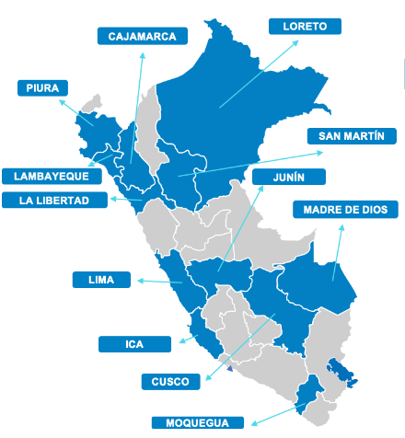
SANITATION SECTOR PPP SCHEDULES
More than 4.8 millon beneficiaries​
PROJECT | PROYECTO​ | APPROVAL OF THE DECLARATION OF INTEREST (UP) OR CALL FOR TENDER | DIRECT AWARD | AWARD IN COMPETITION SCENARIO
1 | Puerto Maldonado WWTP, US$ 89 MM | Reopening of the tender III.Q.23 | - | IV.Q.23
2 | Headworks, US$ 330 MM | Call for Tender: IV.Q.23 | - | II.Q.24
3 | Chincha WWTP, US$ 70 MM | DI: I.Q.24 | II.Q.24 | IV.Q.24
4 | Cusco WWTP, US$ 44 MM | DI: I.Q.24 | II.Q.24 | IV.Q.24
5 | Cajamarca WWTP, US$ 56 MM | DI: I.Q.24 | II.Q.24 | IV.Q.24
6 | Huancayo WWTP, US$ 172 MM | DI: I.Q.24 | II.Q.24 | I.Q.24
7 | San Martín WWTP, US$ 105 MM | DI: I.Q.24 | III.Q.24 | IV.Q.24
8 | Ilo Desalination Plant, US$ 110 MM | DI: I.Q.24 | II.Q.24 | IV.Q.24
9 | Trujillo WWTP , US$ 409 MM | DI: II.Q.24 | III.Q.24 | I.Q.25
10 | Iquitos Rural Sanitation, US$ 26 MM | DI: III.Q.24 | IV.Q.24 | II.Q.25
11 | Cañete WWTP , US$ 33 MM | DI: I.Q.25 | II.Q.25 | IV.Q.25
12 | Lambayeque Desalination Plant, US$ 49 MM | DI: II.Q.25 | III.Q.25 | I.Q.26
13 | Expansion and improvement of Paita and Talara sanitation services, US$ 150 MM | Call for Tender: *II.Q.25 | - | *IV.Q.25
Investment opportunities for more than US$ 1,500 millon
SI
SI
12 beneficiary regions
UP
UP
UP
UP
UP
UP
UP
UP
UP
UP
SI
Notes:
UP
SI
State Initiative
*Optimized scenario
Unsolicited Proposal
Notes:
Linea de tiempo indicando que proyectos se declaran de interés por trimestre

Slide 11
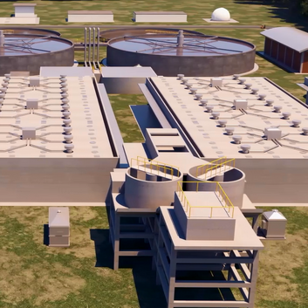



PUERTO MALDONADO WASTEWATER TREATMENT PLANT
ESTIMATED
AWARD DATE
IV Quarter
2023
TRANSACTION
Description
The project consists of designing, financing, constructing, rehabilitating, expanding, operating and maintaining the municipal wastewater collection, treatment and disposal systems in the city of Puerto Maldonado, as well as monitoring and controlling the maximum allowable values.
Main works
Wastewater Treatment Plant (Qp:400 L/s) Sewerage connections (13.808 units) Primary collectors (171,3 km) Secondary collectors (20,9 km)M. Pumping stations (7 units) and Driving lines (4,4 km).
Investment Amount: US$ 89 MM
Co-financed state initiative modality for a term of 22 years.

Slide 12
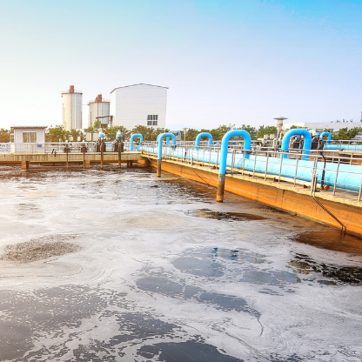
HEADWORKS AND CONDUCTION WORKS FOR THE DRINKING WATER SUPPLY IN LIMA
ESTIMATED AWARD DATE
II Quarter
2024
TRANSACTION
Description
The project includes the design, financing, construction, operation and maintenance of new and existing works to increase the availability of drinking water to expand and improve service to 1.5 million inhabitants in the East and South of Lima.
Investment Amount: US$ 330 MM
Self-financed state initiative modality for a term of 30 years.
Main works
Improvement of Pomacocha and Huallacocha Bajo Dams (38 million m3), Trans-Andean Tunnel (10 km), Huachipa II Plant: Phase 1 of 2,5 m3/s and Phase 2 of 5 m3/s, Huachipa Main Reservoir (160.000 m3), 26 km South Branch with 5 reservoirs (69.000 m3) and Interconnection lines (60 km).

Slide 13
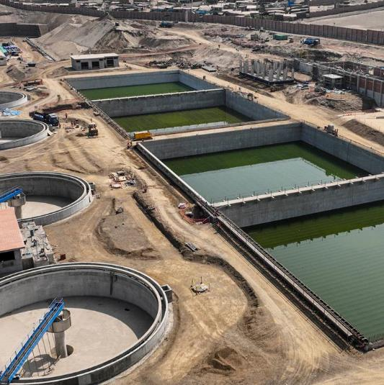
WASTEWATER TREATMENT FOR FINAL DISPOSAL AND/OR REUSE IN THE PROVINCE OF CHINCHA
ESTIMATED DATE OF DECLARATION OF INTEREST
I Quarter
2024
STRUCTURING
Description
The project proposes to optimize the final wastewater collection system by redirecting the flow to 2 new WWTPs. Its main objective is to increase the adequate treatment of wastewater in the area of operation of the Service Provider Company for the province of Chincha, improving the quality of life of the families living in the area of operation.
Investment Amount: US$ 70 MM
Co-financed unsolicited proposal modality for a term of 23 years.
Main works
15 km of interceptor and collector lines, 1 pumping chamber, 6 km of drive lines, 2 outfalls with a total length of 7,7 km, 2 wastewater treatment plants with a total of capacity of 0,6 m3/s and closure of 4 WWTP (lakes).

Slide 14
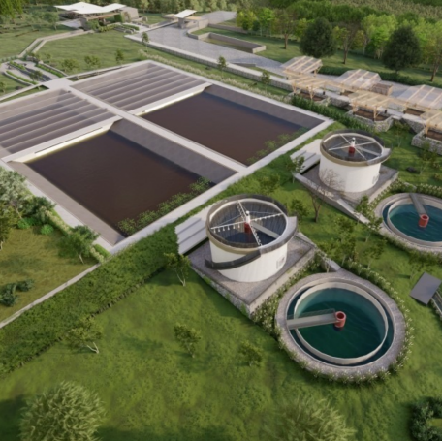
WASTEWATER TREATMENT FOR FINAL DISPOSAL OR REUSE IN THE CITY OF CAJAMARCA
ESTIMATED DATE OF DECLARATION OF INTEREST
I Quarter
2024
STRUCTURING
Description
The project aims to optimize the sewerage network, rehabilitating and expanding the main sewage collectors towards the new La Arenita WWTP.
Investment Amount: US$ 56 MM
Co-financed unsolicited proposal modality for a term of 25 years.
Main works
17 km of interceptor and collector lines, 1 wastewater treatment plant of 0,6 m3/s and 1 outfall with a total length of 1,5 km.

Slide 15
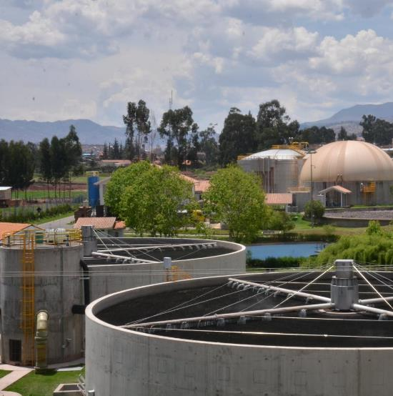
WASTEWATER TREATMENT FOR FINAL DISPOSAL OR REUSE IN THE PROVINCE OF CUSCO
ESTIMATED DATE OF DECLARATION OF INTEREST
I Quarter
2024
STRUCTURING
Description
The project proposes to make investments to expand the capacity of the existing infrastructure for primary conduction (interceptor) and wastewater treatment (San Jerónimo WWTP).
Investment Amount: US$ 44 MM
Co-financed unsolicited proposal modality for a term of 23 years.
Main works
16 km of interceptor and collector lines, capacity increase (to 0,9 m3/s) and improvement of the San Jerónimo wastewater treatment plant and equipment suitable for wastewater treatment.

Slide 16
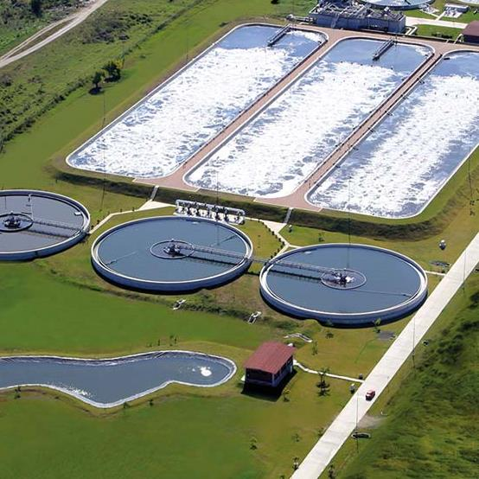
HUANCAYO WASTEWATER TREATMENT PLANT
ESTIMATED DATE OF DECLARATION OF INTEREST
I Quarter
2024
Description
The project contemplates the construction of a treatment plant (WWTP) for wastewater produced in the localities of Huancayo, El Tambo, Chilca and Huancán. It also includes the construction of a WWTP of approximately 34 kilometers of primary and secondary collectors that will intercept the current discharges to the Mantaro, Chilca and Ancalá rivers; these will carry the wastewater to the WWTP, including 8 wastewater pumping stations (EBAR) and their respective discharge lines.
STRUCTURING
Investment Amount: US$ 172 MM
Co-financed unsolicited proposal modality for a term of 23 years.
Main works
35 km of collectors and drive lines, 8 wastewater pumping stations and 1 wastewater treatment plant (approx. 1m3/s).

Slide 17
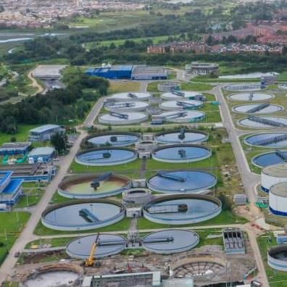
WASTEWATER TREATMENT PLANT PROJECT FOR THE CITIES OF TARAPOTO AND SAN JOSÉ DE SISA
ESTIMATED DATE OF DECLARATION OF INTEREST
I Quarter
2024
FORMULATION
Description
The project proposes the design and construction of sanitary infrastructure (Interceptors, Pumping Stations, Wastewater Treatment Plant and Outfall) and the operation and maintenance of a wastewater treatment plant for the cities of Tarapoto and San José de Sisa.
Investment Amount: US$ 105 MM
Co-financed unsolicited proposal modality for a term of 23 years.
Main works
14 km of interceptor and collector lines, 5 pumping chambers in total and 2 wastewater treatment plants with a total capacity of 0,7m3/s.

Slide 18
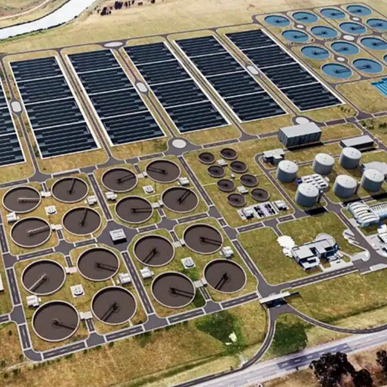
WASTEWATER TREATMENT FOR FINAL DISPOSAL OR REUSE IN TRUJILLO AND CHEPÉN
ESTIMATED DATE OF DECLARATION OF INTEREST
II Quarter
2024
FORMULATION
Description
The project proposes the design and construction of sanitary infrastructure (Sewerage Collector Networks, Sewage Pumping Stations, Drive Lines, Sewage Outfalls, Wastewater Treatment Plants) and the operation and maintenance of three wastewater treatment plants for Metropolitan Trujillo, Salaverry and Chepén.
Investment Amount: US$ 409 MM
Co-financed unsolicited proposal modality for a term of 23 years.
Main works
Improvement of interceptor and collector lines.
​3 wastewater treatment plants with a total capacity of 2,4 m3/s.

Slide 19
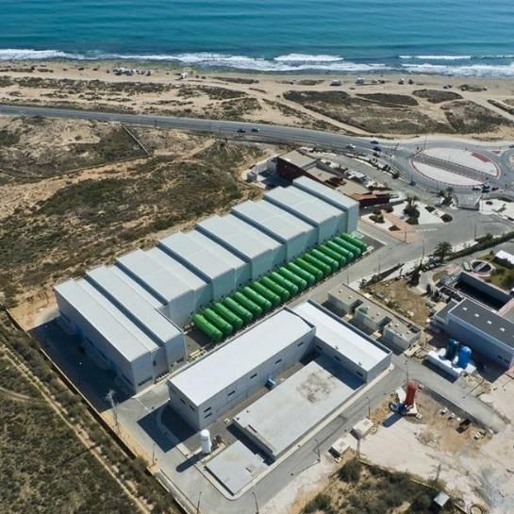
ILO DESALINATION PLANT
ESTIMATED DATE OF DECLARATION OF INTEREST
I Quarter
Description
The project seeks to improve the quality of life of the population of Ilo by desalinating seawater for drinking water service. It will cover the unmet demand for drinking water, provide continuity of service (24 hours) and increase the quality of service, complying with the standards and technical regulations of the Sanitation Sector.
2024
FORMULATION
Investment Amount: US$ 110 MM
Co-financed unsolicited proposal modality for a term of 23 years.
Main works
Two water resources: Pasto Grande Catchment (211 l/s) and Seawater Catchment: (432.93 l/s), improvement and expansion of the Pampa Inalámbrica WWTP, construction of the Desalination Plant of 432.93 l/s, improvement of the existing system pipelines: 6890 m, improvement of existing drives and improvement and rehabilitation works on existing reservoirs.

Slide 20
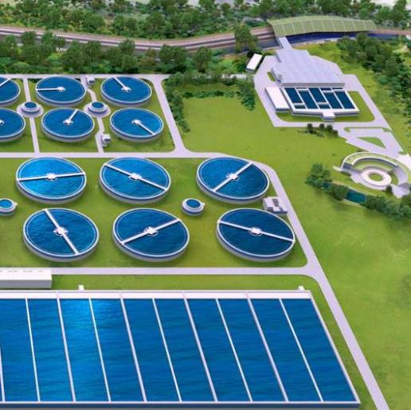
LORETO RURAL SANITATION
ESTIMATED DATE OF DECLARATION OF INTEREST
III Quarter
2024
FORMULATION
Description
The project consists of the construction, installation and commissioning of drinking water and sanitation systems. It proposes the creation and improvement of water and sanitation services, as well as the operation, maintenance and monitoring of services in the 21 prioritized districts of Loreto.
Investment Amount: US$ 26 MM
Co-financed unsolicited proposal modality for a term of 20 years.
Main works
Drinking water plant for each native community.
Disposal of excreta system for each family in the project.

Slide 21
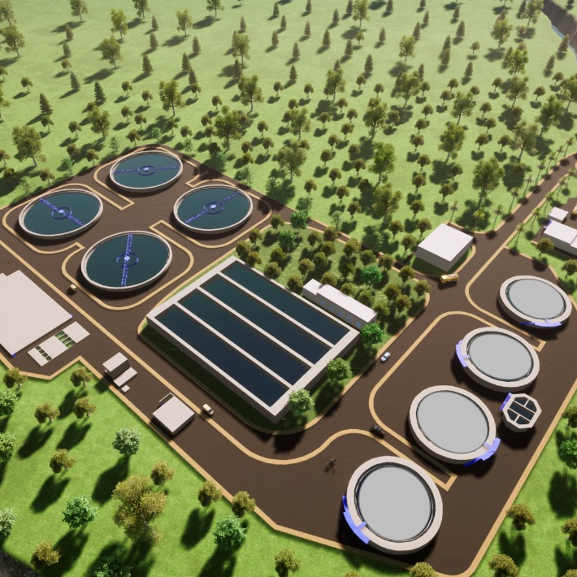
WASTEWATER TREATMENT FOR FINAL DISPOSAL OR REUSE IN CAÑETE
ESTIMATED DATE OF DECLARATION OF INTEREST
II Quarter
2025
FORMULATION
Description
The project proposes the design and construction of sanitary infrastructure (Sewerage Collector Networks, Sewage Pumping Stations, Drive Line, Wastewater Treatment Plants and Outfall) and the operation and maintenance of one wastewater treatment plant for the districts of Cerro Azul, Asia, Quilmana, San Antonio, Mala, San Luis, among others.
Investment Amount: US$ 33 MM
Co-financed unsolicited proposal modality for a term of 23 years.
Main works
A water resource: seawater catchment (545 l/s), construction of a desalination plant (545 l/s) and installation of more than 21 km of drinking water.

Slide 22
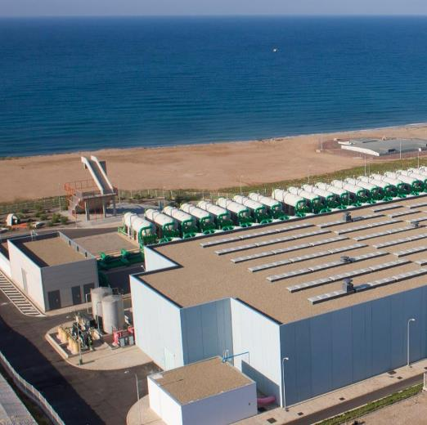
LAMBAYEQUE DESALINATION PLANT
ESTIMATED DATE OF DECLARATION OF INTEREST
II Quarter
2025
Description
The project consists of the design, construction, operation and maintenance of drinking water production infrastructure to improve the quality of life of the urban population of the districts of Lambayeque and San José, through the seawater desalination. The objective is to meet the demand for drinking water service of the beneficiary population and to improve the quality of drinking water service by providing drinking water 24 hours a day.
FORMULATION
Investment Amount: US$ 49 MM
Co-financed unsolicited proposal modality for a term of 23 years.
Main works
Two potential water resources to capture 2 m3/s of water: Chira River catchment and/or Seawater Catchment, improvement and expansion of the El Arenal WWTP and/or construction of Desalination Plants (2 m3/s), Improvement works and installation of driving lines and wastewater treatment plants for 6 districts in the province of Talara.

Slide 23
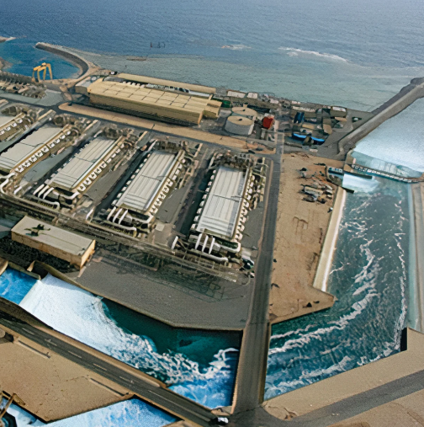
PAITA - TALARA DESALINATION PLANT AND WASTEWATER TREATMENT FOR TALARA
ESTIMATED CALL
FOR TENDER DATE
II Quarter
2025
PLANNING AND PROGRAMMING
Description
The project aims to meet the water demand of the population of the 13 districts of the provinces of Paita and Talara in terms of water quality and service, providing 24 hours a day, through seawater desalination and meeting the technical standards of the Sanitation Sector.
Investment Amount: US$ 150 MM
Co-financed state initiative modality for a term of 23 years.
Main works
Two potential water resources to capture 2 m3/s of water: Chira River catchment and/or Seawater Catchment, improvement and expansion of the El Arenal WWTP and/or construction of Desalination Plants (2 m3/s), Improvement works and installation of driving lines and wastewater treatment plants for 6 districts of province of Talara.

Slide 25

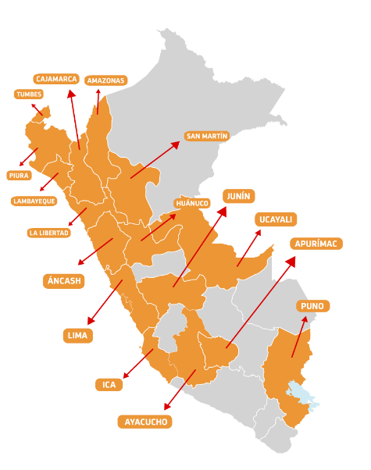
PPP SCHEDULE IN ELECTRICITY
PROJECT | PROYECTO | CALL FOR TENDER | RATING | SUCCESSFUL BID
1-2 | 220 kV Ica - Poroma Link - 220 kV Cáclic - Jaén Link ITC, US$ 73 MM (Awarded) | II.Q.22 | III.Q.22 | Awarded: I.Q.23 Contract signing: II.Q.23
3 | 550 Kv Piura Nueva – Frontera Transmission Line, US$ 223 MM (Awarded) | II.Q.19 | II.Q.23 | Awarded: III.Q.23 Contract signing: IV.Q.23
4-5 | 500 kV Huanuco - Tocache - Celendin - Trujillo Link & 500 kV Celendin - Piura Link, US$ 833 MM | I.Q.22 | II.Q.23 | IV.Q.23
6-10 | 220 kV Belaunde Terry - Tarapoto Norte Link; 500 kV San José - Yarabamba Link; 220 kV Piura Nueva - Colán Link ITC; 220 kV Lambayeque Norte ITC Substation with division; Piura Este Substation, US$ 118 MM (Awarded) | II.Q.22 | III.Q.23 | Awarded: III.Q.23 Contract signing: IV.Q.23
11-28 | (18) Electricity projects binding on Transmission Plan 2023-2032, US$ 870 MM | G1: IV.Q.23 G2: III.Q.23 G3 and G4: IV.Q.23 | G1: I.Q.24 G2: III.Q.23 G3 and G4: IV.Q.23 | G1: II.Q.24 G2: II.Q.24 G3 and G4: II.Q.24
29 | Integrated Gas Transportation System - Southern Zone of Peru US$ 4,321 Million | - | - | -
More than 10 million beneficiaries
SI
Investment opportunities for more than US$ 6,300 MM
17 beneficiary regions
SI
SI
SI
SI
Notes:
UP
SI
State Initiative
Unsolicited Proposal

Slide 26

500 kV HUÁNUCO - TOCACHE - CELENDÍN - TRUJILLO 500 kV LINK
500 KV CELENDÍN - PIURA LINK
ESTIMATED AWARD DATE
IV Quarter
2023
TRANSACTION
Description and main works
500 KV Huánuco – Tocache – Celendín – Trujillo Link:
It corresponds to the expansion of the SEIN in the north of the country, in the departments of Huánuco, San Martín, Cajamarca and La Libertad.
500 kV Celendín – Piura Link: It consists of making viable an alternate electric power transmission axis between the central and northern areas of the country, which will start at the 500 kV Celendín Substation and connect this new substation with the 500 kV Piura Substation.
Investment Amount: US$ 833 MM
Self-financed state initiative modality for a term of 30 years (plus construction period).

Slide 27
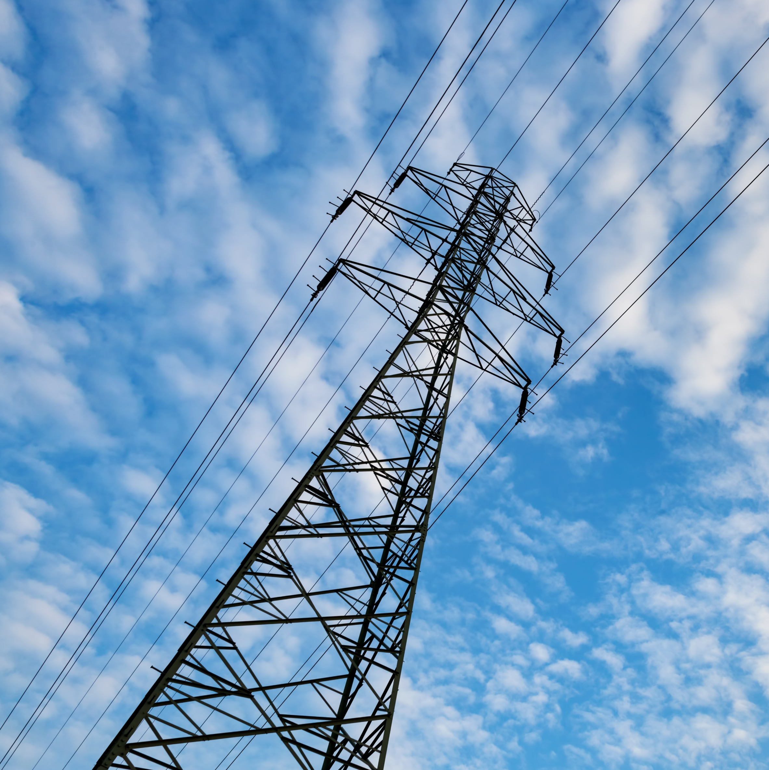
GROUP 2 ELECTRICITY PROJECTS BINDING TO THE TRANSMISSION PLAN 2023-2032
ESTIMATED AWARD DATE
IV Quarter
2023
Description
This group consists of 5 projects:
500 kV Chilca CTM-Carabayllo Link, Transformer Substation Expansion and Air Core Reactor in Chilca CTM Substation (Trunk System) Only component 1
500/220 kV Bicentenario New Substation, expansions and associated substations (Trunk System)
Reconfiguration 220 kV Chavarría – Santa Rosa – Carapongo Link, lines, extensions and associated substations (ITC Project)
220 kV Muyurina New Substation, Ayacucho New Substation, 220 kV Muyurina-Ayacucho Transmission Line, Extensions and Associated Substations (Trunk System + ITC Project)
Supply Capacity Extension of the Ica Electric System (ITC Project)
TRANSACTION
The projects aim to enhance the security of transmission at 500 KV and improve transmission reliability in the Lima, Ica, and Ayacucho regions.
Investment Amount: US$ 290 MM
Self-financed state initiative modality for a term of 30 years (plus construction period).

Slide 28
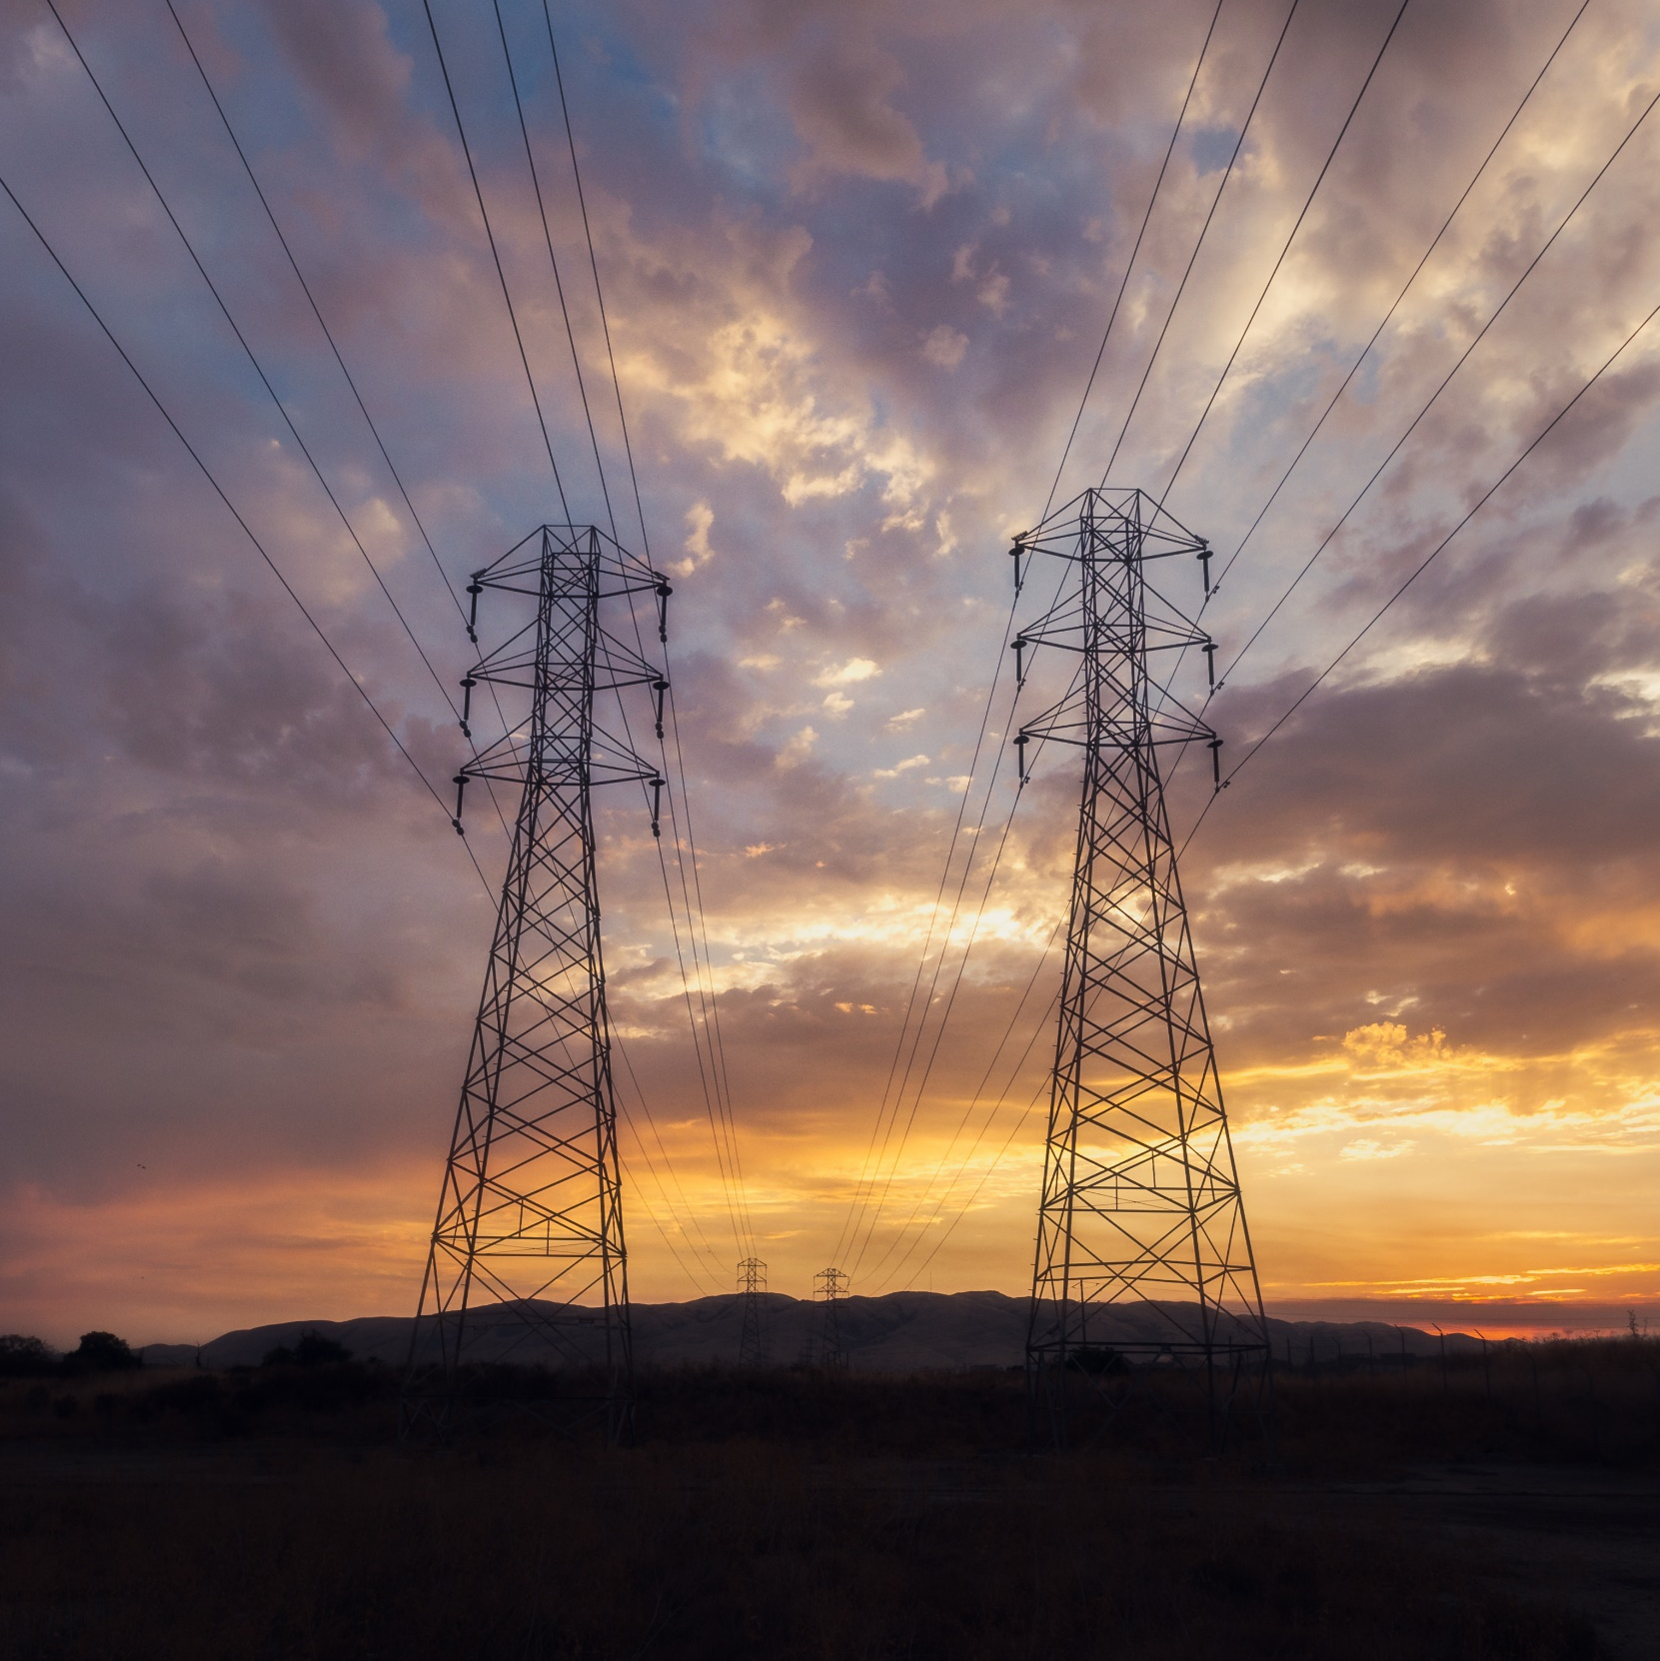
INTEGRATED GAS TRANSPORTATION SYSTEM – SOUTHERN ZONE OF PERU
FORMULATION
Description and main works
This encompasses a natural gas and natural gas liquids transportation system, which will provide supply security to users of the National Interconnected Electric System and the Natural Gas (GN) and Liquefied Natural Gas (GNL) system, known as "Energy Security." It also aims to cover the supply of GN and GNL to users in the major cities of the southern zone of Peru and the Energy Node in Mollendo (Puerto Bravo Power Plant) and Ilo (Ilo Power Plant).
The project will be carried out in two (2) stages:
During STAGE I, activities included: diagnosis, demand analysis, supply analysis, technical analysis of alternative solutions, costs at market prices, social evaluation, sensitivity analysis, probabilistic risk analysis of social profitability, and sustainability analysis. This stage was completed in October 2020.
STAGE II will involve the development of the technical alternative solution selected in Stage I of the Pre-Investment Study, based on the criteria established in Invierte.pe.
Investment Amount: US$ 4,321 MM
Self-financed state initiative modality for a term to be defined.

Slide 29
FORMULATION
(18) ELECTRICITY PROJECTS BINDING TO THE TRANSMISSION PLAN 2023-2032
The Ministry of Energy and Mines, through Ministerial Resolution No. 055-2023-MINEM dated 02.16.2023, entrusted PROINVERSIÓN with 18 electricity projects binding to the Transmission Plan 2023-2032.
No | Binding Projects | Location
1 | 500 kV Chilca CTM-Carabayllo Link, Transformer Substation Expansion and Air Core Reactor in Chilca CTM Substation (Trunk System) Only component 1 | Lima
2 | 500/220 kV Bicentenario New Substation, expansions and associated substations (Trunk System) | Ica
3 | Poroma “Hub” New Substation (First Stage) and 500 kV “Hub” Poroma - Colectora Link, extensions and associated substations. (Trunk System) | Ica
4 | “Hub” San José New Substation – First Stage and 220 kV “Hub” San José Link – Distribution (Arequipa), extensions and associated substations (ITC Project). | Arequipa
5 | Reconfiguration 220 kV Chavarría – Santa Rosa – Carapongo Link, lines, extensions and associated substations (ITC Project) | Lima
6 | 220 kV Muyurina New Substation, Ayacucho New Substation, 220 kV Muyurina-Ayacucho Transmission Line, Extensions and Associated Substations (Trunk System + ITC Project) | Ayacucho
7 | 220 kV Palca New Substation, 220 kV Palca-La Pascana Transmission Line, extensions and Associated Substations (Arequipa) (ITC Project). | Arequipa
8 | 220 kV Aguaytía – Pucallpa Link, substations, lines and associated extensions (ITC Project). | Ucayali
9 | 138-60 KV Reliability Increase of the Tarma - Chanchamayo Electric System. (Trunk System) | Junín
10 | 220 kV Planicie – Industriales Link, extension to III circuit. (ITC Project) (1) | Lima
11 | 138 kV Nueva Virú – Trujillo Sur Link, extensions and associated substations (ITC Project) | La Libertad
12 | Increased capacity and reliability (Criterion N-1) of the Huaraz Electric System Supply (ITC Project) | Ancash
13 | 138 kV Yaros – Amarilis Link (second circuit) (ITC Project) (1) | Huánuco
14 | Supply Capacity Extension of the Ica Electric System (ITC Project) | Ica
15 | Marcona II New Substation and 138 kV Marcona II - San Isidro (Bella Unión) - Pampa (Chala) Link, extensions and associated substations (ITC Project) | Arequipa
 |  | Ica
16 | 138 kV Abancay Nueva – Andahuaylas Link, extensions and associated substations (ITC Project) | Apurímac
17 | 138 kV San Román – Yocara – Maravilla (Juliaca) Link, extensions and associated substations (ITC Project) | Puno
18 | 138 kV Derivación San Rafael - Ananea Link, extensions and associated substations (ITC Project) | Puno

Slide 31
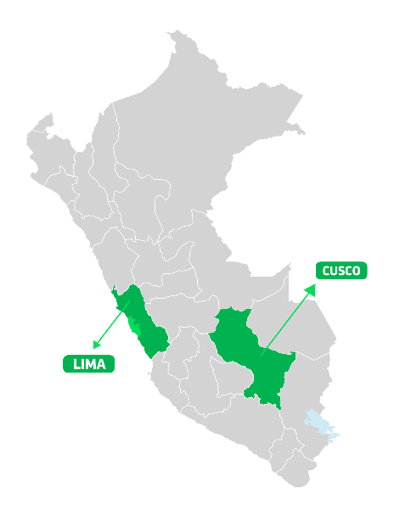
PPP SCHEDULE IN EDUCATION
Investment opportunities for more than US$ 600 MM
PROJECT | PROYECTO | APPROVAL OF THE DECLARATION OF INTEREST | DIRECT AWARD | AWARD IN COMPETITION SCENARIO
1 | Schools at Risk in Metropolitan Lima, US$ 258 MM | I.Q.24 | II.Q.24 | IV.Q.24
2 | Schools at Risk Villa María del Triunfo, US$ 69 MM | I.Q.24 | II.Q.24 | IV.Q.24
3 | Schools at Risk Ate – San Juan de Lurigancho US$ 140 MM | II.Q.24 | IV.Q.24 | I.Q.25
4 | Schools at Risk Comas – San Martín de Porres US$ 91 MM | II.Q.24 | IV.Q.24 | I.Q.25
5 | Reinforcement of infrastructure, equipment and maintenance of Schools in Cusco, US$ 58 MM | II.Q.24 | IV.Q.24 | I.Q.25
More than 77 thousand students benefited
UP
2 beneficiary regions
UP
UP
UP
UP
Notes:
UP
Unsolicited Proposal
SI
State Initiative

Slide 32
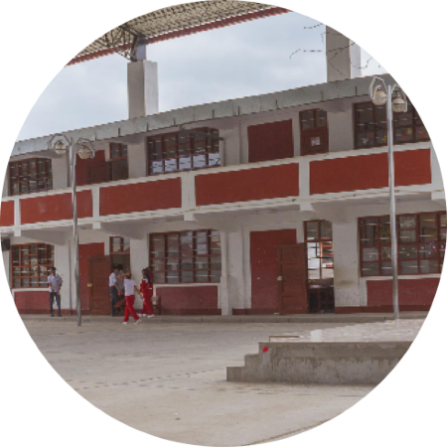
SCHOOLS AT RISK: METROPOLITAN LIMA
ESTIMATED DATE OF DECLARATION OF INTEREST
I Quarter
2024
Description and main works
Availability of infrastructure, furniture and educational equipment. Provision of services: integral cleaning, waste management and pest control, private security and surveillance, and school topics. Administration of an Operational Control Center for services, including the management of basic services. The project will benefit more than 22 thousand students/year.
STRUCTURING
They include 4 regions of Peru. The objective is to strengthen the 13 educational institutions: Execution of a Temporary Relocation Plan. Construction of new educational infrastructure: classrooms, laboratories, workshops, teachers' rooms, academic management offices, sports infrastructure, among others. Equipment and furniture for all educational spaces and environments, electrical system in the corresponding areas and guarantee an efficient supply of electrical energy to end users.
Investment Amount: US$ 258 MM
Co-financed unsolicited proposal modality for a term of 20 years.

Slide 33

SCHOOLS AT RISK: VILLA MARÍA DEL TRIUNFO
ESTIMATED DATE OF DECLARATION OF INTEREST
I Quarter
2024
Description and main works
Availability of infrastructure, furniture and educational equipment. Provision of services: integral cleaning, waste management and pest control, private security and surveillance, and school topics. Administration of an Operational Control Center for services, including the management of basic services. The project will benefit more than 9 thousand students/year.
STRUCTURING
In the 5 educational institutions: Execution of a Temporary Relocation Plan. Construction of new educational infrastructure: classrooms, laboratories, workshops, teachers' rooms, academic management offices, sports infrastructure, among others. Equipment and furniture for all educational spaces and environments.
Investment Amount: US$ 69 MM
Co-financed unsolicited proposal modality for a term of 20 years.

Slide 34

SCHOOLS AT RISK
ATE - SAN JUAN DE LURIGANCHO
ESTIMATED DATE OF DECLARATION OF INTEREST
II Quarter
2024
STRUCTURING
Description and main works
Availability of infrastructure, furniture and educational equipment. Provision of services: integral cleaning, waste management and pest control, private security and surveillance, and school topics. Administration of an Operational Control Center for services, including the management of basic services. The project will benefit more than 24 thousand students/year.
In the 14 educational institutions: Execution of a Temporary Relocation Plan. Construction of new educational infrastructure: classrooms, laboratories, workshops, teachers' rooms, academic management offices, sports infrastructure, among others. Equipment and furniture for all educational spaces and environments.
Investment Amount: US$ 139.58MM
Co-financed unsolicited proposal modality for a term of 20 years.

Slide 35

SCHOOLS AT RISK
COMAS- SAN MARTÍN DE PORRES
ESTIMATED DATE OF DECLARATION OF INTEREST
II Quarter
2024
STRUCTURING
Description and main works
Construction of 3 modern, safe and quality educational institutions, complying with all the standards that ensure the sustainability of the State's investment and strengthen educational management by providing optimal conditions for the development of learning. It includes the provision of furniture and educational equipment, comprehensive cleaning, waste management and pest control, private security, school topic and management of basic services.
In the 3 educational institutions: Execution of a Temporary Relocation Plan. Construction of new educational infrastructure: classrooms, laboratories, workshops, teachers' rooms, academic management offices, sports infrastructure, among others. Equipment and furniture for all educational spaces and environments.
Investment Amount: US$ 90.56MM
Co-financed unsolicited proposal modality for a term of 20 years..

Slide 36
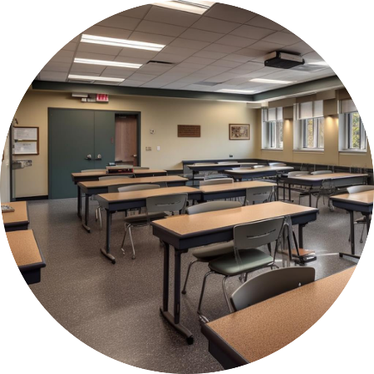
SCHOOLS AT RISK REINFORCEMENT OF INFRASTRUCTURE, EQUIPMENT AND MAINTENANCE OF SCHOOLS IN CUSCO
ESTIMATED DATE OF DECLARATION OF INTEREST
II Quarter
2025
FORMULATION
Description and main works
Availability of infrastructure, furniture and educational equipment. Provision of services: integral cleaning, waste management and pest control, private security and surveillance, and school topics. Administration of an Operational Control Center for services, including the management of basic services. The project will benefit more than 14 thousand students/year.
Contribute to the improvement of learning achievements in the localities served by the educational institutions. The school population of the educational institutions at risk, prioritized in the districts of Cusco, Wanchaq and San Jerónimo, in the province of Cusco, have adequate access to the Regular Basic Education service.
Investment Amount: US$ 58 MM
Co-financed unsolicited proposal modality for a term of 20 years..

Slide 38
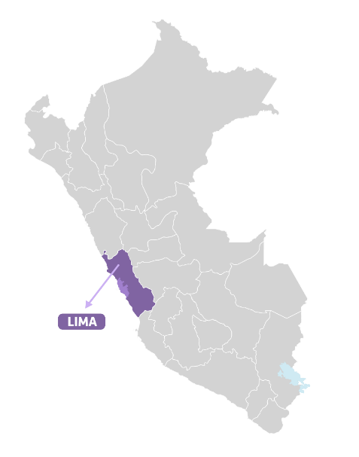
PA SCHEDULE IN REAL ESTATE
1 beneficiary region
PROJECT | PROJECT | CALL FOR TENDER / APPROVAL OF THE DECLARATION OF INTEREST | DIRECT AWARD | AWARD IN COMPETITION SCENARIO
1 | Ancon Industrial Park, US$ 762 MM | - | - | IV.Q.23
Investment opportunities for more than US$ 760 MM
More than 400 thousand inhabitants benefited
SI
Notes:
UP
Unsolicited Proposal
SI
State Initiative
Notes:
Linea de tiempo indicando que proyectos se declaran de interés por trimestre.

Slide 39
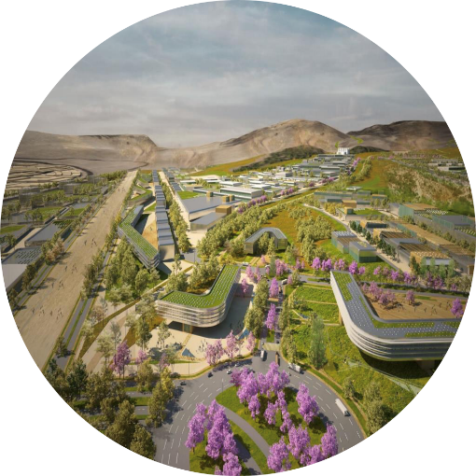
ANCON INDUSTRIAL PARK
ESTIMATED AWARD DATE
IV Quarter
2023
Description and main works
It includes the execution of the Purchase and Sale Contract and the Investment Commitment Agreement to develop the design, financing, construction, urban development, promotion, administration, operation and maintenance of the Ancon Industrial Park in order to offer industrial land lots and provide related services to manufacturing and logistics companies. The land covers an area of 1.338 ha. of which 715 ha. are usable for the development of industrial land. It is strategically located near the Jorge Chávez International Airport (39 km) and the ports of Callao (39 km) and the new port of Chancay (40 km).
TRANSACTION
Main works
Infrastructure development for industrial land and logistics operations, including trade in goods and services. Construction of facilities for the management of common services (water supply, electrical substations, transformation plants, MSW collection center). Public recreation area and business park building. Construction platform for logistics exchange operations and Truck Center services
Investment Amount: US$ 762 MM
State initiative modality for projects in assets for a term of 22 years..

Slide 41
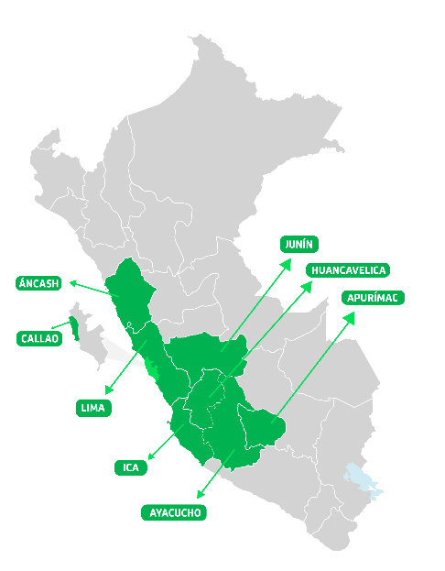
PPP SCHEDULE IN TRANSPORTS AND COMMUNICATIONS
Investment opportunities for more than US$ 4,400 MM
PROJECT | PROJECT | CALL FOR TENDER / APPROVAL OF THE DECLARATION OF INTEREST | DIRECT AWARD | AWARD IN COMPETITION SCENARIO
1 | Longitudinal de la Sierra Section 4, US$ 914 MM | I.Q.23 | - | I.Q.24
2 | Peripheral Ring Road, US$ 2,380 MM | IV.Q.23 | I.Q.24 | III.Q.24
3 | San Juan de Marcona New Port, US$ 405MM | III.Q.23 | IV.Q.23 | II.Q.24
4 | Radio Spectrum Bands in the following frequency ranges: (i) 1 750 - 1 780 MHZ and 2 150 - 2 180 MHZ; and (ii) 2 300 -2 330 MHZ, US$ 268 MM | - | - | Awarded: II.Q.23
5 | Huancayo Huancavelica Railway, US$ 340 MM | I.Q.23 | - | IV.Q.23
6 | Chimbote International Port Terminal, US$ 172 MM | II.Q.24 | III.Q.24 | I.Q.25
More than 6 millon inhabitants benefited
SI
8 beneficiary region
UP
UP
SI
SI
UP
Notas:
UP
Unsolicited Proposal
SI
State Initiative

Slide 42
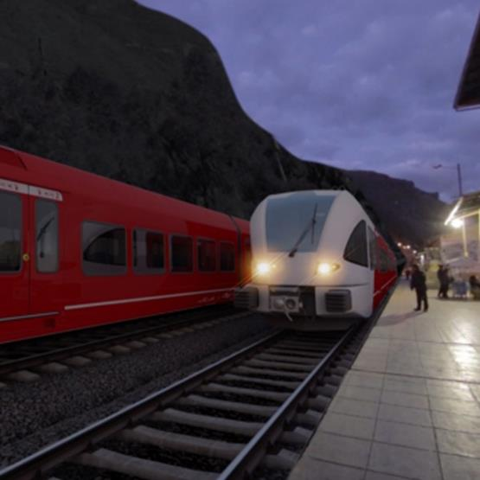
ESTIMATED AWARD DATE
IV Quarter
HUANCAYO – HUANCAVELICA RAILWAY
2023
TRANSACTION
Description
It consists of the execution of the necessary improvement and rehabilitation works along the railroad track (128.7 km), in 2 sections (T178 km; T2 50 km), acquisition of rolling stock with the objective of providing rail transport service through an operator, as well as the maintenance of the infrastructure and rolling stock (CAPEX Work: 80%, CAPEX MR 20%).
Investment Amount: US$ 340 MM
Co-financed state initiative modality for a term of 30 years.
Main works
Renovation of the existing track. Refurbishment of stations and stops. Acquisition of rolling stock (4 DMU railcars, 2 locomotives, 3 Passenger railroad cars, 5 freight warehouses).

Slide 43
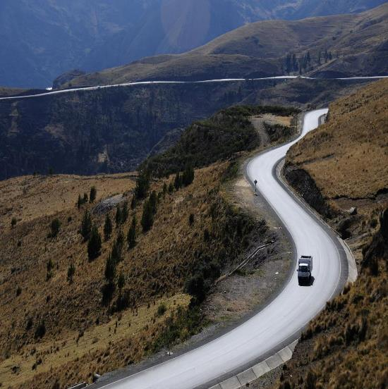
LONGITUDINAL DE LA SIERRA SECTION 4
ESTIMATED AWARD DATE
I Quarter
2024
Description
It includes the design, financing, construction, operation, and maintenance of 965.2 km of highways. The Operation and Maintenance will include Routine Maintenance, Periodic Maintenance and Operation of tolls, weighing and mandatory services to ensure trafficability, meeting service levels and timely attending any road emergency that may occur during the Concession period.
TRANSACTION
Investment Amount: US$ 914 MM
Co-financed state initiative modality for a term of 25 years.
Main works
Construction of the new San Clemente bypass, 5.20 km long.
Rehabilitation and Improvement of the existing Huancayo-Izcuchaca and Izcuchaca-Mayocc subsections, 179.30 km. Initial Periodic Maintenance of the existing subsections Mayocc-Ayacucho-Andahuaylas-Puente Sahuinto and Ayacucho-Huaytará-Div.Pisco, 780.70 km.

Slide 44
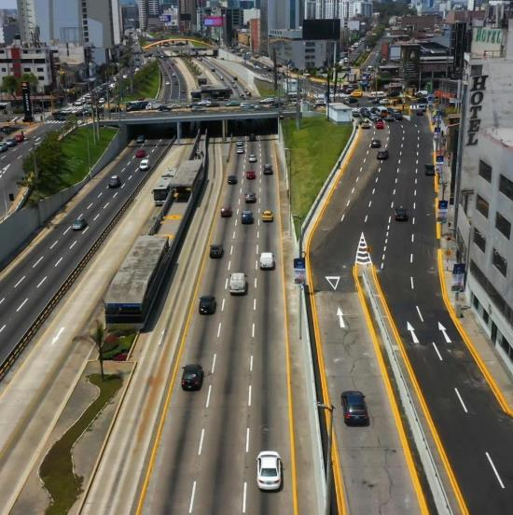
PERIPHERAL RING ROAD
ESTIMATED DATE OF DECLARATION OF INTEREST
IV Quarter
2023
Description
The project consists of the design, construction, financing, operation and maintenance of a 34.8 km long highway, from the 200 miles oval in the Constitutional Province of Callao to the Av. Circunvalación, in the district of San Luis - Lima, including in its area of influence one district in the Constitutional Province of Callao and eleven districts in Metropolitan Lima.
STRUCTURING
Investment Amount: US$ 2,380 MM
Co-financed unsolicited proposal modality for a term of 30 years.
Main works
Construction of a 34.8 km long highway, with 06 lanes at asphalt level. Construction of 2 tunnels with vaults (2.29 km and 1.93 km respectively of 3 lanes each). Construction of bridges, viaducts, overpasses and road interchanges.
(*) It is subject to approval of budgetary capacity.

Slide 45
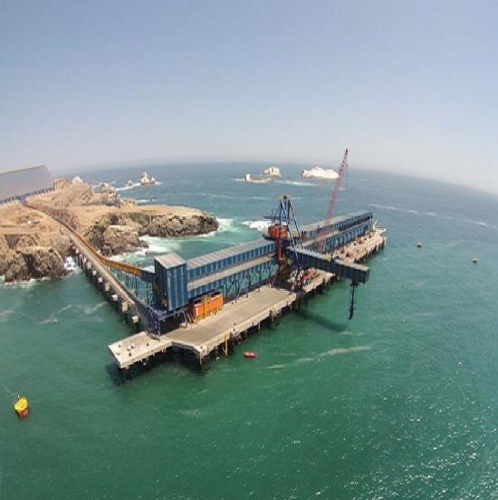
SAN JUAN DE MARCONA NEW PORT
ESTIMATED DATE OF DECLARATION OF INTEREST
IV Quarter
2023
Description
It includes the design, financing, construction, operation and maintenance of a new port terminal for public use with international standards, specialized in providing storage and shipping services for iron and copper concentrates, handling up to 47 million MT of minerals and supplies from the main mining projects in the area. Likewise, it is expected to handle liquid bulk cargo, general cargo, including containers, derived from the needs of mining production in the area.
STRUCTURING
Investment Amount: US$ 405 MM
Self-financed unsolicited proposal modality for a term of 30 years.
Main works
Works related to the construction and operation of the new port terminal. Operation and maintenance according to the standards and service levels: waiting time per vessel, boarding start time and productivity indicators established in the concession contract.

Slide 46
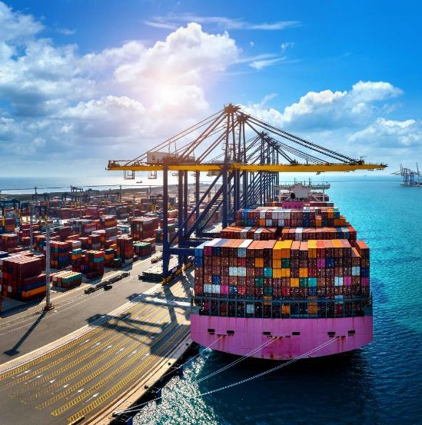
CHIMBOTE INTERNATIONAL PORT TERMINAL
ESTIMATED DATE OF DECLARATION OF INTEREST
II Quarter
2024
FORMULATION
Description
Design, financing, execution of investments, conservation, operation and transfer of the assets included as part of the project for the new multipurpose port terminal at the Port of Chimbote.
Investment Amount: US$ 172 MM
Self-financed unsolicited proposal modality for a term to be defined.
Main works
It proposes to attend to the loading and unloading of cargo, as well as operations directly related to the operation of the terminal, in accordance with the Productivity Service Levels.

Slide 48
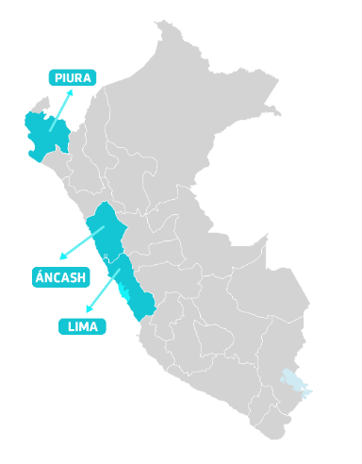
PPP SCHEDULE IN HEALTH
PROJECT | PROYECTO | CALL FOR TENDER / APPROVAL OF THE DECLARATION OF INTEREST | DIRECT AWARD | AWARD IN COMPETITION SCENARIO
1-2 | Two New Hospital Centers: Piura and Chimbote (ESSALUD) , US$ 323 MM | - | - | Awarded: II.Q.23
3 | Operation and Maintenance of the New Villa El Salvador Emergency Hospital, US$ 113 MM* | IV.Q.23 | - | II.Q.24
4 | Operation and Maintenance of the New Cajamarca Hospital US$ 176 MM | II.Q.24 | - | I.Q.25
5 | Integrated Solid Waste Management in Health Facilities of the Ministry of Health in Metropolitan Lima, US$ 24 MM | II.Q.24 | III.Q.24 | I.Q.25
6 | Unanue Hospital US$ 250 MM | I.Q.25 | - | III.Q.25
7 | New Central Military Hospital, US$ 116 MM | IV.Q.24 | II.Q.25 | IV.Q.25
8 | Management of the National Institute of children Health Niño, 16 MM | - | - | -
Investment Opportunities for more than US$ 1000 MM
More than 2.3 million
inhabitants benefited
SI
3 beneficiary regions
SI
SI
UP
UP
UP
Notes:
UP
Unsolicited Proposal
SI
SI
State Initiative
* Total Project Cost is considered since there is no investment component
Notes:
Linea de tiempo indicando que proyectos se declaran de interés por trimestre.

Slide 49
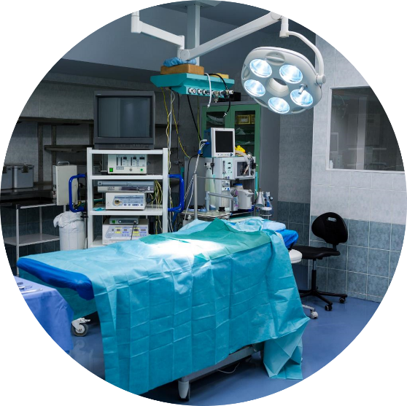
OPERATION AND MAINTENANCE OF THE NEW VILLA EL SALVADOR EMERGENCY HOSPITAL
ESTIMATED DATE OF DECLARATION OF INTEREST
IV Quarter
2023
Description
Maintenance of the building, facilities and electromechanical equipment associated with the infrastructure, maintenance of clinical and non-clinical equipment, and operation and maintenance of general services (food, laundry, cleaning and biosecurity, comprehensive security, the latter being understood as the security and surveillance of the facility).
FORMULATION
Main works
To have the general services covered by the PPP, in an optimal manner that allows contributing to the improvement of specialized and emergency care in the jurisdiction of DISA II LIMA SUR.
Costo total de Proyecto: US$ 113 MM
Co-financed state initiative modality for a term
of 10 years.

Slide 50

OPERATION AND MAINTENANCE OF THE NEW CAJAMARCA HOSPITAL
ESTIMATED DATE OF DECLARATION OF INTEREST
II Quarter
2024
FORMULATION
Description
The project will ensure the maintenance of infrastructure and equipment, as well as the operation of gray coat services (cleaning, security, laundry and clothing, food services, solid waste management, logistics, IT, and sterilization), as well as green coat services (laboratory, hemodialysis, and imaging) to guarantee specialized and emergency care at the Cajamarca Hospital.
Main works
Having the general services provided by the Public-Private Partnership (PPP) in an optimal manner will contribute to the enhancement of specialized and emergency care at the Cajamarca Hospital.
Investment Amount: US$ 176.32 MM
Co-financed state initiative modality for a term yet to be defined.

Slide 51

INTEGRATED SOLID WASTE MANAGEMENT IN HEALTH FACILITIES OF THE MINISTRY OF HEALTH IN METROPOLITAN LIMA
ESTIMATED DATE OF DECLARATION OF INTEREST
II Quarter
2024
FORMULATION
Description
Solid waste conditioning, segregation, storage, transportation, treatment and disposal services for 387 health facilities of the Ministry of Health in Metropolitan Lima.
Main works
Build, operate and maintain facilities for the treatment ofspecial and biocontaminated solid waste.
Investment Amount: US$ 24 MM
Co-financed unsolicited proposal modality for a term of 20 years.

Slide 52

UNANUE HOSPITAL
ESTIMATED DATE OF DECLARATION OF INTEREST
I Quarter
2025
Description
The project aims to enhance the provision of healthcare services at the Hipólito Unanue National Hospital, situated in the El Agustino district, province, and department of Lima. To achieve this, the project entails the construction of a new hospital along with comprehensive equipment, as well as the ongoing maintenance and operation of general services.
FORMULATION
Main works
Construction of a new hospital, comprehensive equipment, maintenance, and operation of general services.
Investment Amount: US$ 250 MM
Co-financed unsolicited proposal modality for a term of 18 years.

Slide 53

NEW CENTRAL MILITARY HOSPITAL
ESTIMATED DATE OF DECLARATION OF INTEREST
IV Quarter
2024
Description
The project consists of designing, constructing, maintaining and operating the Central Military Hospital. It arises from the necessity of the Army members to have a state-of-the-art hospital considering the most innovative issues in certifications such as, LEED 2009, leadership in energy and sustainable design.
FORMULATION
Main works
Replace the more than 55-year-old infrastructure of the Central Military Hospital with a modern one that meets all the characteristics of a state-of-the-art hospital; as well as to guarantee the sustainability of medical care to the beneficiary population for the life of the project.
Investment Amount: US$ 116 MM
Co-financed unsolicited proposal modality for a term of 30 years.

Slide 55
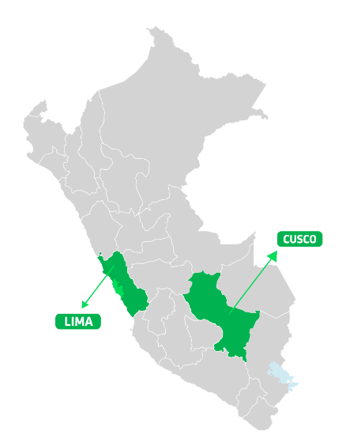
PPP SCHEDULE IN TOURISM
Investment Opportunities for more than US$ 200 MM
PROJECT | PROJECT | CALL FOR TENDER / APPROVAL OF THE DECLARATION OF INTEREST | DIRECT AWARD | AWARD IN COMPETITION SCENARIO
1 | Cerro San Cristóbal Cable Car, US$ 16 MM | I.Q.24 | II.Q.24 | IV.Q.24
2 | Lima Convention Center Operation and Mantenance US$ 78 MM | II.Q.24 | - | IV.Q.24
3 | Improvement of Public Tourist Services of Choquequirao Archaeological Park US$ 190 MM | III.Q.24 | - | I.Q.25
More than 9 millon de inhabitants benefited
UP
3 beneficiary regions
SI
SI
Notes:
UP
Unsolicited Proposal
SI
State Initiative

Slide 56
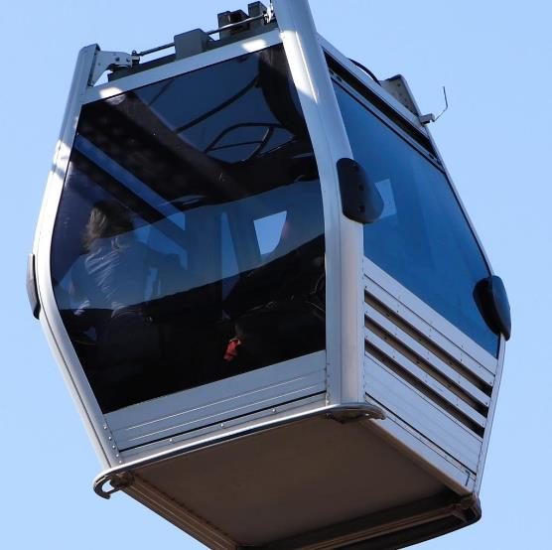
ESTIMATED DATE OF DECLARATION OF INTEREST
I Quarter
CERRO SAN CRISTÓBAL CABLE CAR
2024
STRUCTURING
Description
It consists of the design, financing, construction, equipment, operation and maintenance of the means of tourist accessibility to Cerro San Cristóbal (Department and province of Lima, district of Rímac), by means of cable transport systems.
Investment Amount: US$ 15.7 MM
Self-financed unsolicited proposal modality for a term to be defined.
Main works
Development of infrastructure to install the cable transport system.

Slide 57
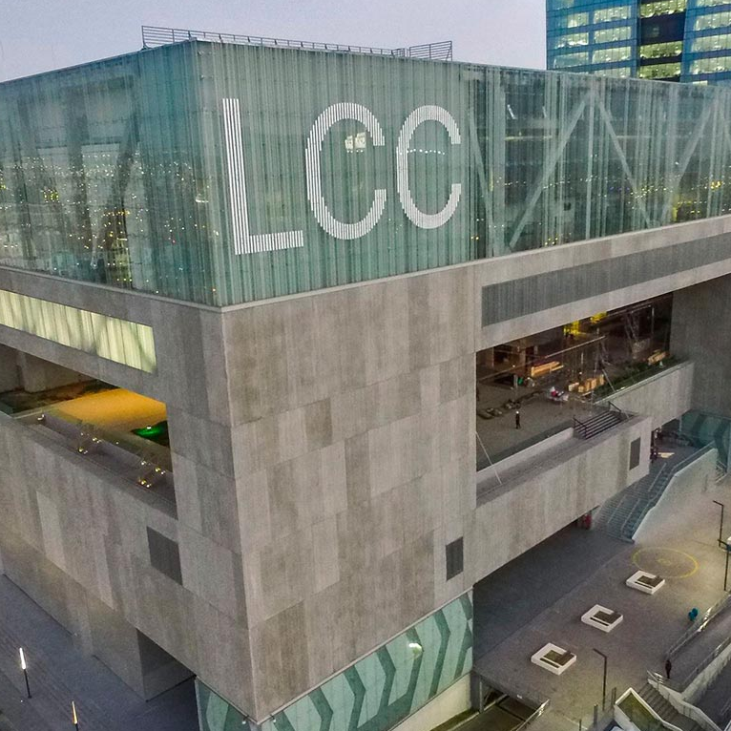
ESTIMATED AWARD DATE
III Quarter
OPERATION AND MAINTENANCE OF LIMA CONVENTION CENTER
2024
TRANSACTION
Description
Operation, Exploitation, Conservation, and Comprehensive Maintenance of the Lima Convention Center
Investment Amount: US$ 78 MM
Co-financed state initiative modality for a term to be defined.

Slide 58
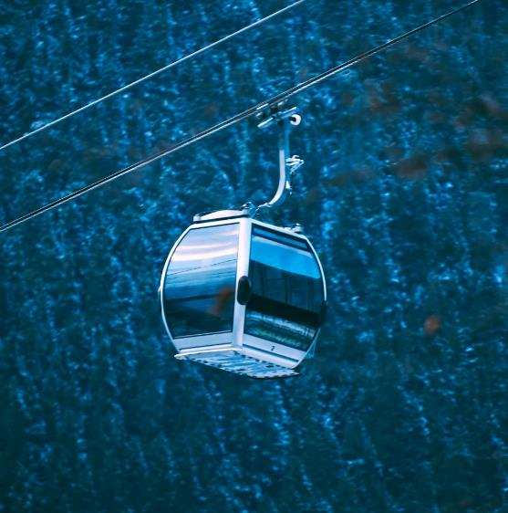
CHOQUEQUIRAO PROJECT
ESTIMATED DATE OF DECLARATION OF INTEREST
III Quarter
2024
Description
The project consists of the design, financing, construction, equipment, operation and maintenance of a cable car as an access road from Kiuñalla (Apurimac Region) to the Choquequirao Archaeological Park (Cusco Region), as well as the departure and arrival stations. The cable car will cross the Apurimac Canyon (1 400 m).
FORMULATION
Investment Amount: US$ 190 MM
Co-financed state initiative modality for a term to be defined.
Main works
Development of infrastructure to install the cable transport system.

Slide 60
AGRICULTURE AND IRRIGATION SCHEDULE
Investment Opportunities for more than US$ 1100 MM
PROJECT | PROJECT | CALL FOR TENDER / APPROVAL OF THE DECLARATION OF INTEREST | DIRECT AWARD | AWARD IN COMPETITION SCENARIO
1 | Chinecas Project (US$ 500 MM) | - | - | -
2 | Comprehensive Water System of the Chancay Valley - Lambayeque US$ 619 MM | - | - | III.Q.26
2 beneficiary regions
Lambayeque
SI
UP
Notes:
UP
Unsolicited Proposal
SI
State Initiative
Notes:
Linea de tiempo indicando que proyectos se declaran de interés por trimestre.

Slide 61
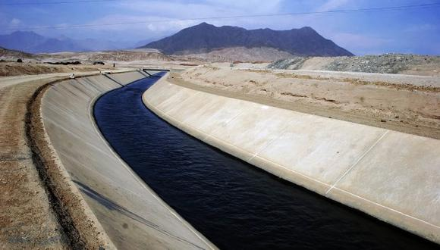
ESTIMATED AWARD DATE
2026
CHINECAS PROJECT
PLANNING AND PROGRAMMING
Description
It involves the diversion of a portion of the waters from the Santa River to enhance, stabilize, and expand the regulated water supply service for irrigation in the Chinecas project areas of the Santa, Casma, and Huarmey provinces in the Ancash department. Additionally, it will be used to provide water for the population.
Investment Amount: US$ 500 MM
Co-financed state initiative modality for a term to be defined.

Slide 62
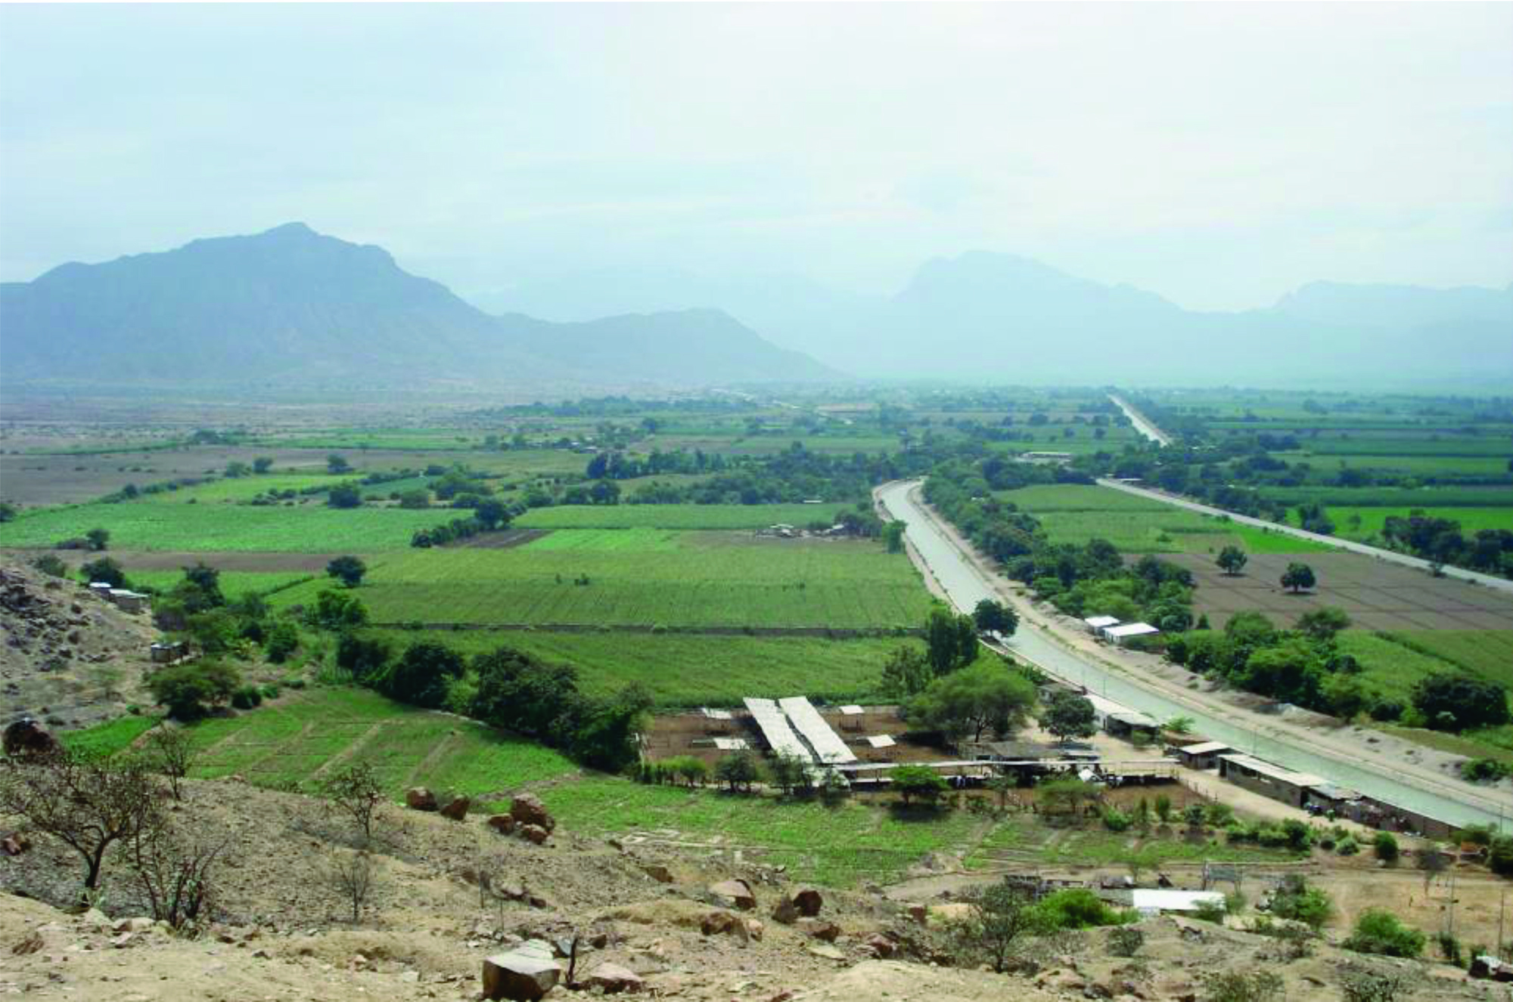
Comprehensive Water System of the Chancay Valley - Lambayeque
ESTIMATED AWARD DATE
III Quarter
2026
FORMULATION
Description
involves the design, construction, and operation of the comprehensive water system in the Chancay-Lambayeque Valley. This includes the construction of two dams (Montería and Sicán) and the execution of conveyance and distribution works to irrigate 33,200 new hectares. Additionally, it will encompass the operation and maintenance of existing structures (currently under the management of PEOT). Currently, efforts are being made to negotiate the signing of the Institutional Collaboration Agreement between GORE LAMBAYEQUE, MIDAGRI, and PROINVERSIÓN, which, among other aspects, will allow changes in the scope of the IPC (Private Investment Promotion).
Investment Amount: US$ 619 MM
Co-financed unsolicited proposal modality for a term of 25 years.

Slide 63
Projects in the process of incorporation and/or evaluation
Project Owner​ | Projects | Actual state​** | Referencial Amount (Mill. $/)​
Transports | 18 Road Conservation Projects | Project in coordination | 1071
Transports​ | Backbone Network O y M | Project in coordination | To be defined
Transports​ | Chincheros Airport (Cusco) O y M ​ | Project under evaluation | To be defined
Transports​ | Third Group of Airports​ | Project under evaluation | 692
Transports​ | 5G Spectrum Bands | Project under evaluation | 1351
Transports​ | Lambayeque Port Terminal | Project in progress | To be defined
Transports​ | Cusco Aerodrome | Project in coordination​ | To be defined
Transports​ | LEGADO Facilities (Sports Complex, Pan American Village, and others) | Project in coordination​ | To be defined
Transports​ | Pan-American Highway Section (Ica - Quilca Bypass) | Project under evaluation​ | 592​
Transports​ | Piura-Tumbes Dual Carriageway | Project under evaluation | To be defined​
Transports​ | Pucallpa Port Terminal | Project under evaluation | To be defined
Transports​ | Lima-Ica Railway (Suburban Train) | Project in coordination​ | 864
Transports​ | New Port Terminals in Loreto (Saramiza and Iquitos) | Project under evaluation​ | To be defined​
Energy | Natural Gas Distribution Project in Arequipa, Moquegua, and Tacna | Project in coordination | 60​
Energy | Bayovar Brine Mining Project | Project in coordination | To be defined
Energy | ANAP ajaruni Project Mining | Project in coordination | 22
Sanitation​ | Wastewater Treatment Plants and Desalination Plants of MVCS (Barranca, Huaura, and others) | Project under evaluation​ | To be defined​
Sanitation | Management Contract for EPS Grau | Project under evaluation | To be defined
Tourism​ | Puno Cable Car | Project in coordination | 20​
​ | ​ | TOTAL​ | 4,672*
Project Owner
*Estimated amount based on available reference amounts (exchange rate of 3.7).
**Projects under evaluation: These are projects whose execution modality is currently being evaluated, with a high likelihood of being entrusted to Proinversión..
Projects in progress: These are projects that have not yet been included in the portfolio but are progressing through various milestones.
Projects under coordination: These are projects that are in the process of being entrusted to Proinversión.

Slide 64

LIST OF UPCOMING PROJECTS
Project Owner
Project
Project Owner
Project
Transports | Lima - Ica Railway (Suburban Train)
Transports | Train Link with Metro Line 1
Transports | Grau Train
Transports | Operation and Maintenance of the Dorsal Network
Transports | Sierra Longitudinal Highway Section 5
Transports | San Juan de Marcona - Andahuaylas - VRAEM Railway
Transports | Expansion and Extension of Metro Line 1
Transports | Metro Line 3
Transports | Metro Line 4
Transports | Access Road to Chinchero Airport
Transports | Aerodrome Projects in Provinces
Transports | South Coastal Highway
Transports | Pan-American Highway Section (Ica - Quilca Bypass)
Transports | Arequipa Mass Transit Corridor
Transports | South Expressway
Education | High performance School Facilities - COAR Northeastern
Education | Improvement of San Antonio Abad University in Cusco (Faculty of Sciences)
Education | Improvement and Expansion of San Antonio Abad University in Cusco
Education | Improvement of Specialized Educational Services in San Martín
Education | High performance School Facilities - COAR South
Agriculture | Ica Water Assurance System
Agriculture | Chinecas Special Irrigation Project
Agriculture | Chancay-Lambayeque Irrigation Project
Sanitation | Wastewater Treatment Plants Rescue Plan
Sanitation | Huaraz Wastewater Treatment Plant
Sanitation | Lambayeque Wastewater Treatment System
Sanitation | Expansion of the Chira
Production | Ilo Industrial Park
Production | Tacna Industrial Park
Health | Chulucanas Hospital
Health | Sullana Hospital
Health | Castilla Health Center
Health | El Faique Health Center
Health | Limón de Porcuya Health Center
Health | Mancora Health Center
Health | Sechura Health Center
Health | Talara Health Center
Health | Cascas Hospital
Health | Matucana Hospital
Health | Posope Alto Health Center
Health | Yungay Hospital
Health | Recuay Hospital
Health | Pomabamba Hospital
Health | Caraz Hospital
Health | Casma Hospital
Health | San Nicolas Health Center
Health | Yungar Health Center
Tourism | Muna Cable Car
Tourism | Manchay Cable Car
Tourism | Installation of Cable Accessibility Service - Cable Car on the Hills of El Agustino and Catalina Huanca, El Agustino District, Province of Lima
Tourism | Installation of Cable Accessibility Service - Cable Car connecting the districts of Independencia and San Juan de Lurigancho, Province of Lima
Tourism | Muna Cable Car

